Slide 1
Welcome to the Early Childhood SEL Leadership Series!
As you join the call, please:
Mute your microphone (for now)!
Turn your video on so we can all see each other!
Pull up:
Session 5 handouts
The “Nation at Hope” excerpt that was attached to the materials email
Know that you do not need to worry if pets, children, spouses, or other family members make guest appearances during our call today. ☺
Notes:
9:00
Pull up following videos in advance:
Slide 23: https://www.youtube.com/watch?v=007jTSdsrg0&list=PLbOD7zOyxjTthyvrn3LrrL8EyZXkfvSCh (0:40-4:07)
Slide 27: https://www.youtube.com/watch?v=bMxpUwgLs_Y&list=PLG5a7din-gkIBqxwqfaq1r4mMet2Hx4Tz&index=13 (full video)
Slide 28: https://www.youtube.com/watch?v=fdZJiWnxhg0&list=PLG5a7din-gkIBqxwqfaq1r4mMet2Hx4Tz&index=3 (full video)
Slide 41: https://crtandthebrain.com/start-with-responsive/ (play 1:00-the end)

Slide 2
Opening & Reflection
Nevada Early Childhood SEL Series
Session 5
Notes:
9:00-9:01
35 min opening session (9:00-9:35)
Welcome participants with warmth and enthusiasm!
Headline for session: During our work today, we will spend time reflecting on where we are in our own social-emotional journey, get concrete about supporting SEL throughout the entire day, and continue learning about culturally-responsive teaching in early childhood environments.

Slide 3
Session Objectives
Preview the scope of work for the day
Build our relationships
Check in on our own social-emotional well-being
Share and reflect on where we are with our learnings from the previous session
Notes:
9:01-9:02
Share objectives for the session

Slide 4
Cohort Agreements
Stay child-centered
Stay present mentally, but take care of yourself
Give each other grace
Challenge yourself to step outside your comfort zone
Seek to understand and be understood
Lead with equity in mind and voice
What’s learned here leaves here
(PS: Please stay on mute when not speaking! ☺)
Notes:
9:02-9:03
Briefly revisit norms

Slide 5
Agenda
Opening and Icebreaker
Checking In, Sharing, and Reflecting
Notes:
9:03-9:04

Slide 6
Icebreaker
Part 1: What’s the Weather?
If how you were feeling today was a weather forecast, what would it be? Rainbow, sunny, partly cloudy, overcast, raining, or thunderstorm?
Take a brief moment to put your answer in the chat.
Part 2: Breakout Group Share
In your breakout room, share your forecast and why you’re feeling that way today. (And it’s ok if you are feeling a combination of different “forecasts”!)
Share—what are some things that bring sun and rainbows into your personal “forecast”?
Notes:
9:04-9:15
11 minutes total
2 mins whole group
6 mins small group
3 mins for folks to share in whole group

Slide 7
Agenda
Opening and Icebreaker
Checking In, Sharing, and Reflecting
Notes:
9:15-9:16

Slide 8
Checking In
Handouts, Page 1
Spend the next few minutes silently journaling in response to the questions below:
Where am I emotionally today? What is fueling those emotions? How is my body physically responding to those emotions? (Pro tip: Check in with, but don’t dive into, your emotions. As you’re looking at yourself and assessing how you feel, back up a little. Consciously ‘look at’ your feelings as if you were viewing them from the outside. The goal is to acknowledge your emotions. Allow them to inform you, not overwhelm you.)
What do I most need from my colleagues today, to successfully engage in the work ahead of me?
What do I need to do to take care of myself today, so I can successfully engage in the work ahead of me?
Notes:
9:16-9:21
5 minutes

Slide 9
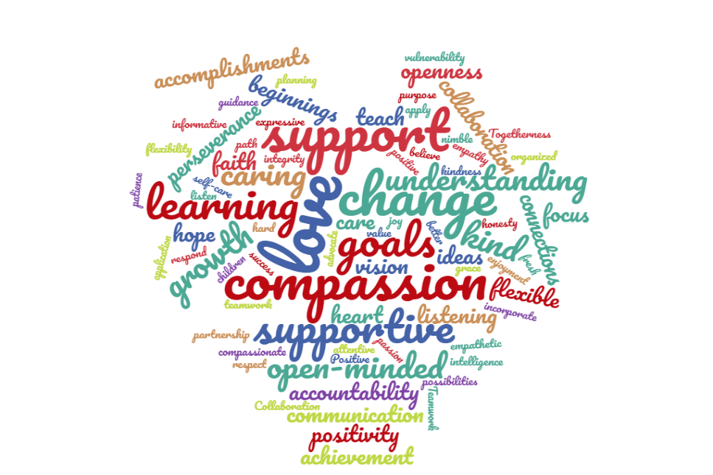
Reflecting on where we’ve been and where we are today
In your small group, discuss:
How did you share SEL training content with your teachers since our previous session? How did they respond? What went well, and what was challenging?
What came up for you during the journaling activity? What can your fellow cohort members do to support you?
Be prepared to share highlights from your discussion with the whole group when we return.
Notes:
9:21-9:30
9 mins. total
6 mins: Breakout groups—3 or 4 per group
3 mins: Share take-aways whole group

Slide 10
Catching our breath
Notes:
9:30-9:40
5 mins—starfish breathing
5 mins—break
Walk participants through “starfish breathing”. Ask them to reflect on how they feel after taking just a few minutes to focus on their breath. Make connections to how this strategy can help teachers and children as well.
5 min break before content.

Slide 11
Do Now
Handouts, Page 2
Take a few minutes to list all the ways that social-emotional learning is practiced (intentionally or unintentionally) throughout the day in your center(s) or school(s).
Notes:
9:40-9:43
Have participants complete the Do Now.
Share that we will return to the Do Now shortly.

Slide 12
Integrating Social-Emotional Skills Throughout the Day
Nevada Early Childhood SEL Series
Session 5
Notes:
9:40-11:00 overall (80 min. session)
9:43-9:45
2 minutes
Welcome participants to the session with excitement. Today we will begin to put all of our learning from the previous four sessions together by considering how to effectively teach social-emotional skills throughout the entire day in our classrooms. We’ll consider all 5 competencies and the myriad of ways we can support SEL development in those competencies across the day.

Slide 13
Objectives
Articulate the connection between social-emotional development and content-based knowledge to young children’s future success in school and life
Understand and describe what it means to incorporate social-emotional development throughout the day, in all environments, with a focus on integration with academics
Identify and plan for opportunities to connect SEL to literacy, math, science, centers, and the world around us
Notes:
9:45-9:46
SHARE objectives for the session.

Slide 14
Agenda
Opening
Why Integrate SEL Across the Day?
How to Integrate SEL Across the Day
Planning to Integrate SEL Across the Day
Closing
Notes:
9:46-9:47
Transition to the next section of the presentation.

Slide 15
Do Now
Handouts, Page 2
Take a few minutes to list all the ways that social-emotional learning is practiced (intentionally or unintentionally) throughout the day in your center(s) or school(s).
Notes:
9:47-9:50
3 mins—whole group share

Slide 16
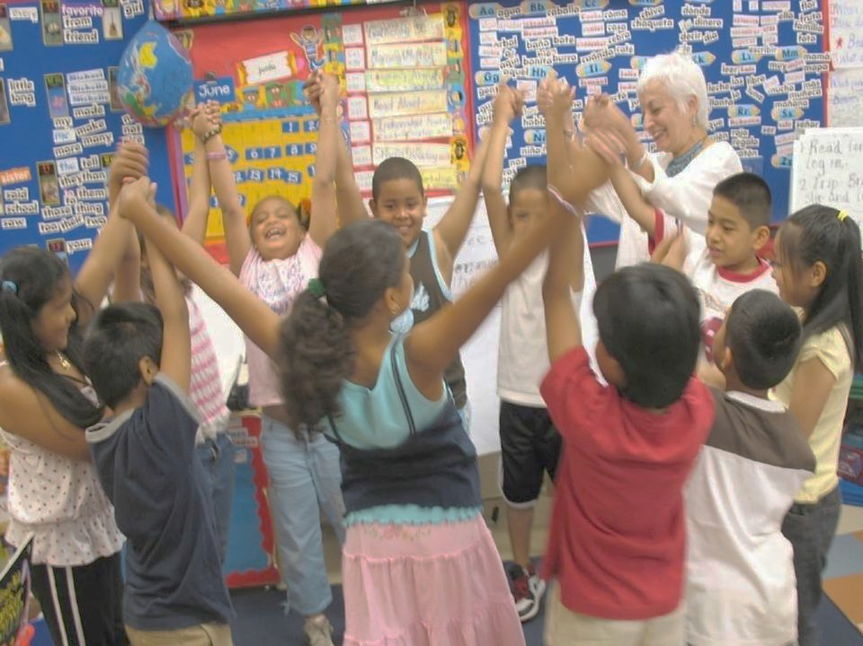
SEL is…
Social and emotional learning (SEL) is an integral part of education and human development. SEL is the process through which all young people and adults acquire and apply the knowledge, skills, and attitudes to develop healthy identities, manage emotions and achieve personal and collective goals, feel and show empathy for others, establish and maintain supportive relationships, and make responsible and caring decisions.
SEL advances educational equity and excellence through authentic center- or school-family-community partnerships to establish learning environments and experiences that feature trusting and collaborative relationships, rigorous and meaningful curriculum and instruction, and ongoing evaluation. SEL can help address various forms of inequity and empower young people and adults to co-create thriving centers and schools and contribute to safe, healthy, and just communities.
Notes:
9:50-9:51
1 min
Reground in definition of SEL.

Slide 17
Why connect SEL to everything we do?
“A Nation at Hope” Excerpt
As you read the excerpts from this article:
Put a checkmark beside quotes/passages that stand out to you
Put a star next to new learning
? Put a question mark next to anything you’d like to learn more
about
Notes:
9:51-10:07
16 minutes
(8 mins to read, 6 mins for small group discussion, 2 mins share out whole group)

Slide 18
Connecting this work to the Pyramid Model
WE ARE HERE
Notes:
10:07-10:08
1 min
As we mentioned before, this training is not a TACSEI/Pyramid Model, but if you are using the Pyramid Model approach, it should strengthen/deepen your knowledge of how to build an effective workforce in your center and how to support teachers in building nurturing and responsive relationships and setting up high-quality supportive environments.

Slide 19
Agenda
Opening
Why Integrate Connect SEL Across the Day?
How to Integrate SEL Across the Day
Planning to Integrate SEL Across the Day
Closing
Notes:
10:08
Transition to the next section of the presentation.

Slide 20
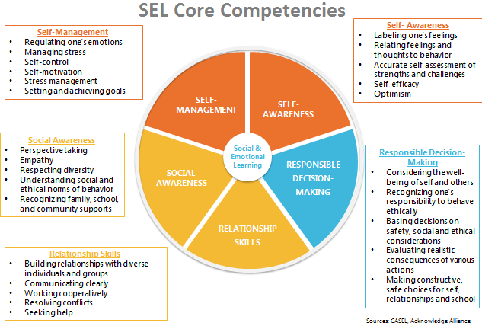
Revisiting the five Social-Emotional Competencies
Handouts, Page 3
Notes:
10:08-10:09
1 min
BRIEFLY revisit to provide overview and framing for where we’re focusing today.
Today we’ll be pulling all our knowledge related to all 5 competencies together to consider how we holistically support SEL development in everything we do.
Take a minute to revisit each of the competencies and the skills/behaviors that align to each.

Slide 21
Examples of the social-emotional competencies
Guideline or Standard | Competency
Express feelings, needs, or wants appropriately with adult guidance | Self-Awareness
Follow routines and familiar activities with adult/teacher direction | Responsible Decision-Making
Empathize with the feelings of other children | Social Awareness
Able to entertain themselves for brief periods of time; able to calm themselves when mildly distressed | Self-Management
Play for longer periods of time with other children, instead of mostly beside them | Relationship Skills
Notes:
10:09-10:12
3 mins.
As a quick refresher--show each example of a guideline or standard and ask participants to enter into the chat which SEL competency it most closely aligns to.
After each guideline, animate slide to show competency.
NOTE: There are times when a guideline or standard supports more than one competency! They are all intertwined, so that overlap is to be expected!

Slide 22
Evidence of Social-Emotional Learning
Handouts, Page 4
As you watch the video, take notes on the following question:
Where do you see evidence of children practicing social-emotional skills?
Notes:
10:12-10:25
13 minutes total
3 minutes-video (0:40-4:07) https://www.youtube.com/watch?v=007jTSdsrg0&list=PLbOD7zOyxjTthyvrn3LrrL8EyZXkfvSCh
2 minutes-independent work
5 minutes-small groups
3 minutes whole group
SAY: We’re going to watch a two-minute clip of a prechool classroom in the art center. As you watch, take notes on any time you notice children practicing social-emotional skills. After the video, you’ll have a few minutes to independently match what you saw with the corresponding competency.
Show video.
Provide 2-3 minutes for participants to complete their chart.
In breakout groups, share what you noticed.
Whole group: How were children given the opportunity to practice social emotional skills in a variety of ways during this brief clip?
https://www.youtube.com/watch?v=iHj6zSTGixo&feature=youtu.be

Slide 23
We’ve talked about the “why” and the “what”. What about the “how”?
Notes:
10:25-10:26
1 minute
Briefly revisit key points from previous session:
Research has shown that social and emotional development can be fostered, and social and emotional skills, attitudes, and behaviors can be taught using a variety of approaches, primarily:
-Free-standing lessons designed to enhance children’s social and emotional competence explicitly.
-Teaching practices such as play-based, cooperative learning, and project-based learning, which promote SEL.
-Integration of SEL into content-based topics like language arts, math, social studies, or science.
-Organizational strategies that promote SEL as a centerwide initiative that creates a climate and culture conducive to learning from the top down.
Graphic: https://casel.org/what-is-sel/approaches/

Slide 24
Social-emotional teaching
Handouts, Page 5
Explicit SEL Skills Instruction
Specific, planned activities for large or small groups of children to teach and practice a targeted social-emotional skill
Teacher Instructional Practices
Noticing and capitalizing on naturally occurring opportunities (“teachable moments”)
Promoting SEL through interactions and relationships
Integration with Academics
Reinforcing opportunities for SEL throughout the entire day
Intentionally planning for SEL practice during centers, reading and literacy, math, science, social studies, etc.
Organizational, Culture, and Climate Strategies
Center and classrooms are warm, inviting, and promote physical and emotional safety
Notes:
10:26-10:28
2 minutes
Briefly revisit the 4 key strategies of social-emotional teaching.
Name that in Session 2, we did a brief overview of all 4 skills, but in each remaining session, we’ll take a closer look at one teaching strategy in conjunction with the competencies we’re learning about.
Children develop social and emotional skills primarily through interactions with parents, teachers, siblings, and peers. With many children spending large amounts of time in early education settings, the influences of early childhood teachers on children’s social and emotional learning is critically important.
Teachers promote social and emotional learning through a variety of activities and practices, some purposeful and planned, some naturally occurring.
Today we are going to focus on Integration with Academics, and in our final session, we’ll continue our discussion about integration of SEL by digging into Organizational, Culture, and Climate strategies.

Slide 25
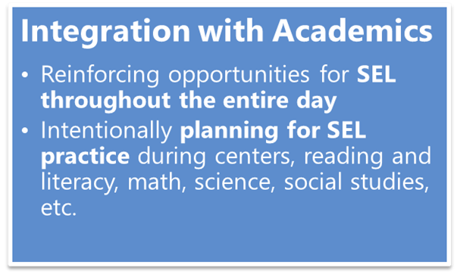
Integration with Academics
Handouts, Page 6
“SEL is not one more thing on the plate.
It is the plate.”
Be Intentional
Let Children Do the Thinking
Accessibility + Rigor
Active and Engaging
Notes:
10:28-10:33
5 minutes
Integration with Academics refers to the essential practice of teaching children academic content and SE skills in an intentionally interwoven way throughout the day. Teachers know the importance of teaching the whole child, and that no learning happens in a vacuum. The more we intentionally integrate SEL opportunities thoughtfully within other learning opportunities during the day, the better practice children will get across all their skills.
There are a few principles that help guide the social-emotional teaching practice of integrating SEL with academics. (Talk through principles listed on the slide)
Be intentional: Social and emotional skills come up all the time — at recess, in group work, in center time, during morning meeting. Be intentional about identifying opportunities to practice the skills with children, and build targeted skills into plans to best maximize those opportunities. Social-emotional learning opportunities are already going to be there in everything our children are doing and learning—it’s up to teachers to name those skills for children, and purposefully build opportunities for children to learn social-emotional skills while also engaging in learning across other domains.
Let Children Do the Thinking: When integrating SEL with other content areas and parts of the day, make sure the majority of learning opportunities give children the chance to practice and engage with social-emotional skills. Teachers should still model, role play, provide language, etc. as necessary, but don’t over-intervene; give children chances to practice, make mistakes, self-correct, and problem solve!
Accessibility+Rigor: Make sure learning opportunities are always accessible to children in developmentally-appropriate ways, but also challenge children to grow, try, and learn new things—in more academic areas and in social-emotional skill development! This could mean having choice for how to engage in particular activities, how much teacher support is provided during different learning times, etc.
Active and Engaging: As with all learning in our early childhood classroom, the learning of content and social-emotional skills should be hands-on, active, and fun!
Sources:
https://casel.org/wp-content/uploads/2018/10/SEL-Trends-3-10232018.pdf
https://www.gse.harvard.edu/news/uk/19/01/teaching-social-and-emotional-skills-all-day

Slide 26
Examples of Integration with Academics
Handouts, Page 7
Be Intentional
Let Children Do the Thinking
Accessibility + Rigor
Active and Engaging
Where do you notice the principles of integration with academics in this quick video?
Notes:
10:33-10:37
4 mins.
2 mins: video (https://www.youtube.com/watch?v=bMxpUwgLs_Y&list=PLG5a7din-gkIBqxwqfaq1r4mMet2Hx4Tz&index=13)
2 mins: where did you notice the principles of integration with academics in this quick video?
Be Intentional: Planning
Let Children Do the Thinking: Design example
Accessibility + Rigor: Scaffolded example
Active and Engaging: Morning Meeting example (active song/finger play?)

Slide 27
Examples of Integration with Academics
Handouts, Page 7
As you watch the video, take notes on where you specifically see the integration of academic learning and exploration with the building of social-emotional skills.
Notes:
10:37-10:45
8 mins.
1 min for set-up
3 mins for video: https://www.youtube.com/watch?v=fdZJiWnxhg0&list=PLG5a7din-gkIBqxwqfaq1r4mMet2Hx4Tz&index=3
4 mins-whole group debrief

Slide 28
Reflect
Handouts, Page 8
How are your teachers already integrating SEL within academics? How can you support them to strengthen these practices?
What opportunities to integrate SEL with academics exist over the course of a typical day in your center(s) or school(s)?
Notes:
10:45-10:50
5 mins
Individual reflection

Slide 29
Break ☺
Notes:
10:50-10:56
6 mins.

Slide 30
Agenda
Opening
Why Integrate SEL Across the Day?
How to Integrate SEL Across the Day
Planning to Integrate SEL Across the Day
Closing
Notes:
10:56-10:57
1 minute
Transition to the next section of the presentation.

Slide 31
Planning to Integrate SEL with Academics
Handouts, Page 9
Think of one of the classrooms in your center(s) or school(s), and independently brainstorm:
In that classroom, what are the biggest opportunities to intentionally integrate SEL with academics?
How could teachers in that classroom incorporate SEL more intentionally into other learning?
Which SEL competencies would children be practicing?
Be prepared to share your thinking in small groups!
Notes:
10:57-11:19
22 minutes
2 mins. for directions
8 mins for independent planning
10 mins. for small group discussion
4 mins. whole group

Slide 32
Agenda
Opening
Why Integrate SEL Across the Day?
How to Integrate SEL Across the Day
Planning to Integrate SEL Across the Day
Closing
Notes:
11:19-11:20
1 min.
Transition to the next section of the presentation.

Slide 33
“What’s Learned Here, Leaves Here”
Handouts, Page 10
What are your biggest take-aways from this session?
What are you most excited to share with your teachers?
How will you carry this learning forward in your own work?
Notes:
11:20-11:25
5 minutes
*provide quick 3 minute break here since we’re going straight into CRT session*

Slide 34
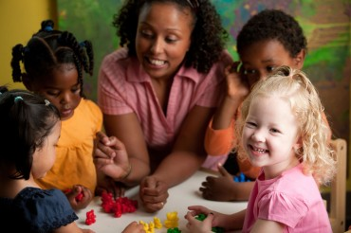
Do Now
Handouts, Page 11
Recall an important teacher in your own life. How would you describe the relationship? What made it feel like a partnership?
How do you build relationships across difference?
Notes:
11:25-11:29
4 mins.
Direct participants to complete their Do Now independently. Jot down ideas in their notes for now.

Slide 35
Culturally Responsive Teaching in ECE: Part 2
Nevada Early Childhood SEL Series
Session 5
Notes:
11:29-11:30
1 minute
Welcome participants to our second session on CRT. In our previous session we began to lay the foundation for Awareness, and built our understanding of the roots and levels of culture and how they impact a child’s experience in their classroom.
Today we will be regrounding in that foundation, and digging into building meaningful relationships with children to support them in achieving their fullest potential under less stress.

Slide 36
Objectives
Explain why Culturally Responsive Teaching (CRT) is an essential framework for early childhood classrooms
Understand the principles of Culturally Responsive Teaching, with particular focus on the Relationships component of the Ready for Rigor framework
Plan to lay the foundations for Meaningful Relationships in classrooms across your center
Notes:
11:30-11:31
1 minute
Review the objectives and make additional connections about how today’s session will help participants in their centers.
COLD CALL participants to read each of the objectives aloud.

Slide 37
Agenda
Opening
Why Culturally Responsive Teaching?
Beginning with Meaningful Relationships
Plan and Closing
Notes:
11:31
1 minute
Provide an overview of the agenda, describing how you will meet the session objectives over the course of the session.

Slide 38
Do Now
Handouts, Page 11
Recall an important teacher in your own life. How would you describe the relationship? What made it feel like a partnership?
How do you build relationships across difference?
Notes:
11:31-11:36
5 mins.
Whole group share

Slide 39
Agenda
Opening
Why Culturally Responsive Teaching?
Beginning with Meaningful Relationships
Plan and Closing
Notes:
11:36
Provide an overview of the agenda, describing how you will meet the session objectives over the course of the session.

Slide 40
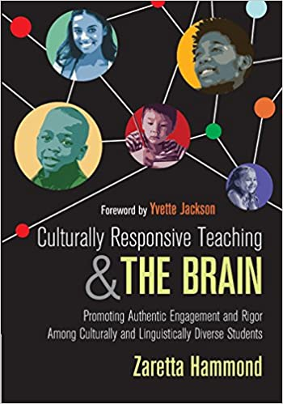
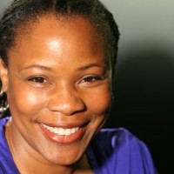
Start with Responsive
Handouts, Page 12
As you listen to the “blogcast”, respond to the following questions:
What is the “true starting point” for culturally responsive teaching?
What are your major takeaways from this brief blogcast?
Notes:
11:36-11:54
18 minutes total
9 mins: blogcast
6 mins: small group breakouts
3 mins: whole group share
Play blogcast 1:00-end
https://crtandthebrain.com/start-with-responsive/

Slide 41
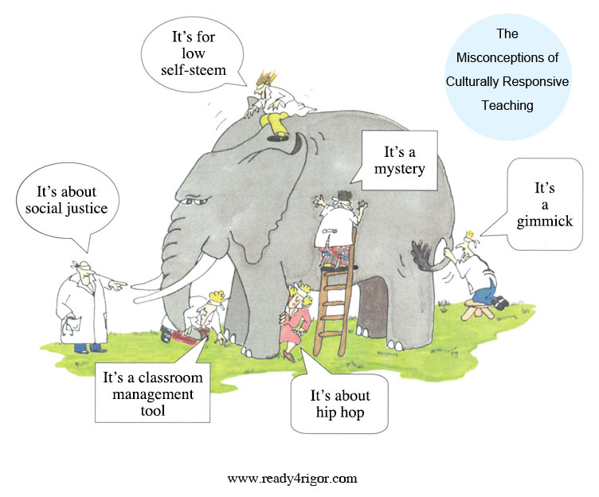
What is Culturally Responsive Teaching?
Handouts, Page 13
“An educator’s ability to recognize students’ cultural displays of learning and meaning-making and respond positively and constructively with teaching moves that use cultural knowledge as a scaffold to connect what the student knows to new concepts and content in order to promote effective information processing. All the while, the educator understands the importance of being in relationship and having a social-emotional connection to the student in order to create a safe space for learning.”
Notes:
11:54-11:56
2 mins
Briefly revisit CRT definition from Part 1.
(original notes below)
When Zaretta Hammond opens her sessions on CRT, she asks groups to describe what CRT is. More often than not, every group emphasizes a different aspect of culturally responsive teaching that is a mix of truth and misconceptions. It’s like the story of the king who asked six blind men to tell them what an elephant was like. One felt his tail and said it was like a rope. Another had hold of a big floppy ear and likened the elephant to a fan. And so it went.
Well, that’s pretty much what it’s like hearing folks talk about culturally responsive teaching. In reality it isn’t a set of best practices, but a process.
Read the definition of CRT aloud.
Have participants enter key words/phrases into the chat

Slide 42
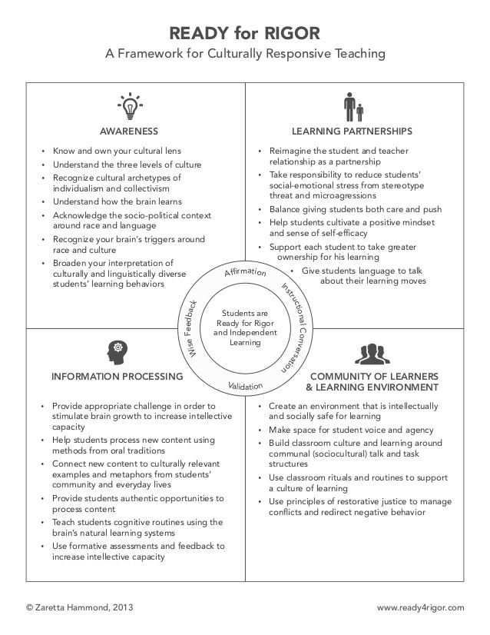
A Framework for Culturally Responsive Teaching
Handouts, Page 13
Notes:
11:56-11:57
1 minutes
Briefly revisit the framework. Name that today we’ll be digging into the “Learning Partnerships” element.
(original notes below)
To best understand CRT, what educators need is a framework for organizing the process. The Ready for Rigor frame takes the key elements of cultural responsiveness and organizes them into four practice areas. Unlike the individual part of the elephant that is mistaken for the whole, each area of the frame is interdependent with the others. The social-emotional and cognitive aspects of teaching and learning show up in each area. At its core is the neuroscience that unifies the frame: the brain’s reaction to living in a racialized world as well as how it programs itself using culture.
Then there is the inner circle with the four staple practices of every culturally responsive teacher.
Affirmation – noticing and naming the unique talents and gifts of each child, especially those culturally grounded ways of being and expressing oneself.
Validation – acknowledging to children through word or deed the impact of unearned disadvantage in a racialized society without guilt or excuses.
Instructional Conversation — talking with children regularly about their learning process in order to move them safely into their zone of proximal development.
“Wise” Feedback – providing children with wise feedback, what Claude Steele says is the anecdote to stereotype threat. It is corrective feedback that first affirms the child‘s capacity to meet the goal or standard, tells him honestly where he missed the mark, gives him actionable steps to improve his learning, and helps him monitor his progress.
There’s no magic to the Ready for Rigor frame and it’s not the only culturally responsive frame out there. The real point is that you have to have some type of framework to make culturally responsiveness operational. The art of cultural responsiveness lies in weaving together these four practices areas into a process that calms the brain and sets the stage for neuroplasticity where the brain can grow itself.

Slide 43
Agenda
Opening
Why Culturally Responsive Teaching?
Beginning with Meaningful Relationships
Plan and Closing
Notes:
11:57
Provide an overview of the agenda, describing how you will meet the session objectives over the course of the session.

Slide 44
What does neuroscience tell us about trust and relationships?
TRUST→Oxytocin (“bonding hormone”)
Notes:
11:52-11:57
5 mins.
Name up front that the next few slides will be a bit of me talking to share information, then we’ll all do some exploration and integration of this content together.
The second practice area of the Ready for Rigor frame is focused on reframing and repositioning child-teacher relationships as the key ingredient in helping culturally and linguistically diverse learners authentically engage.
Why? In a collectivist, community-based culture, relationships are the founcation of all social and cognitive endeavors. All human beings are hardwired for relationships after living in communal, cooperative settings for millions of years.
At the core of positive relationships is trust. Caring is the way that we generate the trust that builds relationships. We have to not only care about children in a general sense, but also care for them in a physical and emotional sense.
Neuroscience tells us the brain feels safest and relaxed when we are connected to others we trust to treat us well. It responds to this connection by secreting oxytocin, called the bonding hormone. Oxytocin makes us want to build a trusting relationship with the other person we are interacting with. Simple gestures (a smile, nod of the head, pat on the back, etc.) from another person stimulates the release of oxytocin in the recipient.
More than that, researchers found that when individuals won the trust of another, their own brains responded by producing oxytocin—to make sure we connect with others, our brains developed “mirror neurons” to keep us in sync with each other. Mirror neurons encourage us to match our body language and facial expressions to the other person’s to signal trust and rapport. This synchronizing dance triggers our relaxation response, and we feel more trusting. The culturally responsive teacher uses thi sinformation to make a more personal and authentic connection with children across differences.

Slide 45
Rapport, Affirmation, and Validation
Handouts, Pages 17-19
FEAR→Amygdala→Cortisol (“fight/flight/freeze”)
TRUST deactivates the amygdala.
Notes:
11:57-12:01
4 mins.
The only way to get children to open up to us is to show we authentically care about who they are, what they have to say, and how they feel. Caring within a culturally responsive context automatically places teachers in a different kind of emotional and academic partnership with children. This relationship is anchored in affirmation, mutual respect, and validation that breeds an unshakable belief that all our children, including our most marginalized, not only can but will learn and achieve to their fullest potential.
Rapport is generally defined as a sympathetic connection with another person that results in that warm, friendly feeling you get when you are in sync. In CRT, rapport is connected to the idea of affirmation.
Affirmation simply means that we acknowledge the personhood of our children through words and actions that say to them “I care about you”. Affirmation and rapport are about building trust. Trust and fear are inversely related; fear activates the amygdala and the release of cortisol, which triggers the fight, flight, or freeze responses, and stops all learning for about 20 minutes. Trust deactivates the amygdala and blocks the release of cortisol, therefore freeing up the brain for other activities like creativity, learning, and problem solving.
In the inner circle of the Ready for Rigor framework, affirmation and validation are two practices that undergird all efforts to operationalize rapport building. Affirming is simply acknowledging the personhood of each child, appreciating all aspects of them especially those culturally specific traits that have been negated by the dominant culture. Validation, on the other hand, is your explicit acknowledgement to children that you are aware of the inequities that impact their lives.

Slide 46
Building Trust and Rapport
Notes:
12:01-12:05
4 minutes
Feeling connected grows slowly and requires time for people to get to know each other. It happens in our small day-to-day interactions. Children begin to feel cared for when they recognize and experience familiar forms of affection and nurturing.
Wondering where to start? Trust begins with listening. The most powerful way to build rapport is by practicing what Reggio Emilia practitioners call a pedagogy of listening. Listening communicates a sense of respect for and an interest in the child’s contributions.
Research says that 70% of communication is nonverbal. Consider what this means for our youngest learners who are still making sense of the world! Listening doesn’t just mean hearing words that children are saying, but the emotional quality of the interaction. Even before we try to make a connection with children by being friendlier or sharing of ourselves, effective CRT practitioners start with listening. We need the kind of empathetic, attentive listening that builds rapport every day.
ASK: Many of us work with children who are not yet using words and sentences. What could empathetic, attentive listening look like with our youngest children?

Slide 47
Break
Notes:
12:05-12:10
5 minutes

Slide 48
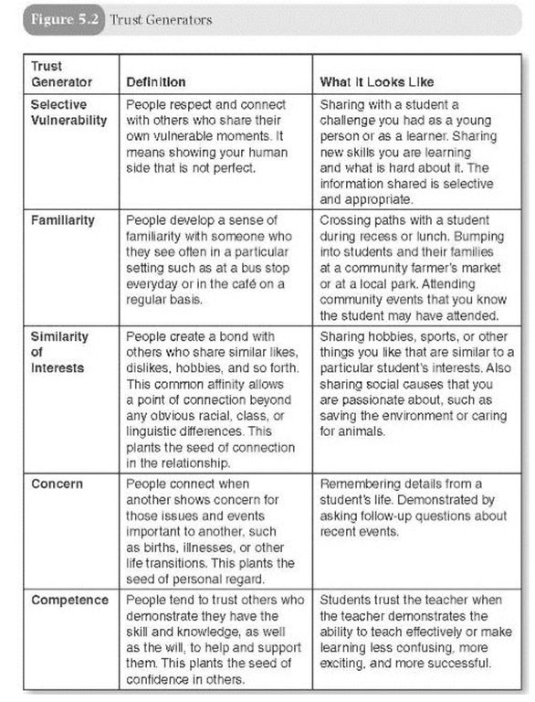
Trust Generators
Handouts, Page 14
Notes:
12:10-12:19
9 mins
5 mins—read and annotate
4 mins—which of these resonate with you most? Which have you used before? Which would be new to try?

Slide 49
Operationalizing Trust Generators
Selective Vulnerability in Action:
Tell your own story by weaving it into classroom stories/activities. What were you like as a child? What were your favorite things? What were some of your challenges? Bring in pictures of yourself as a child.
Share a new skill you are trying and learning—not the perfect ending, but the tricky beginning and middle parts.
Find common interests with children. Let children make connections that are meaningful to them.
Notes:
12:19-12:24
5 minutes
3 mins—examples of operationalizing selective vulnerability
2 mins—any additional ideas?

Slide 50
Reflection
Handouts, Page 15
How do you create a sense of trust and rapport in your relationships with children?
What do you do deliberately? What do you do randomly?
Notes:
12:24-12:30
6 mins.
Individual reflection

Slide 51
Agenda
Opening
Why Culturally-Responsive Teaching?
Beginning with Meaningful Relationships
Plan and Closing
Notes:
12:30

Slide 52
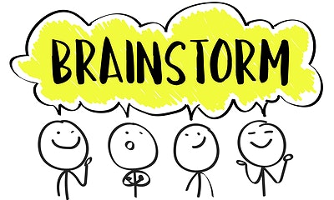
“My Points of Connection”
Handouts, Page 16
Take the next several minutes to brainstorm in the “My Points of Connection” worksheet.
Then, with your partner, share what you brainstormed and any “aha” moments you’re taking away from this exercise.
Notes:
12:30-12:46
16 minutes
7 mins—individual brainstorm
7 mins—partners
2 mins—whole group share

Slide 53
“What’s Learned Here, Leaves Here”
Handouts, Page 17
What are your biggest take-aways from this session?
What are you most excited to share with your teachers?
How will you carry this learning forward in your own work?
Notes:
12:46-12:50
4 minutes

Slide 54
Closing and Reflection
Nevada Early Childhood Leadership Series
Session 5
Notes:
12:50-1:00
12:50

Slide 55
Session Objectives
Reflect on key concepts learned during the day
Articulate the next steps to take prior to the next session
Provide feedback on the day’s session
Notes:
30 seconds (unnecessary to spend time here)
12:50-12:51

Slide 56
Agenda
Reflecting on the Day
Looking Ahead to Our Next Session: Next Steps
Self-Assessment and Feedback Survey
Notes:
12:50-12:51

Slide 57
Let’s look back at the content we covered today.
Choose one of the questions below and put your answer in the chat:
What are your biggest take-aways from the content that was covered throughout the day today?
What will you do to make sure that you “live the learning” from today’s session? What will you do next week? Next month? Throughout the rest of the year?
How were you feeling at the beginning of today’s session? How are you feeling now? Why do you think that is?
Notes:
12:51-12:54

Slide 58
Agenda
Reflecting on the Day
Looking Ahead to Our Next Session: Next Steps
Feedback Survey
Notes:
12:54

Slide 59
Next steps prior to our next training:
Handouts, Pages 18
Prior to our next training:
Our next and final training will be Thursday, April 8th from 9 AM-1 PM PST.
Share content with teachers (virtually or in-person) from any of the sessions we’ve engaged in so far.
Make sure to collect exit tickets/feedback from your teachers to bring to share during Session 6
Notes:
12:54-12:56
2 mins

Slide 60
Agenda
Reflecting on the Day
Looking Ahead to Our Next Session: Next Steps
Feedback
Notes:
12:56

Slide 61
Providing Feedback
Please take the next two minutes to complete the feedback survey for today’s sessions. It is posted in the chat—please complete the survey before logging off.
Notes:
12:56-1:00
https://forms.gle/ScDJareyEt5qfx4C9

