Slide 1
Do Now
In our opening session, you were asked to do some independent reflection, small group sharing, and whole group sharing. Think closely about what you needed to be able to do to be successful in those activities, then respond to the questions below:
What self-awareness skills did you need to engage successfully in our opening session?
What self-management skills did you need to engage successfully in our opening session?
Notes:
3 mins
Have participants complete the Do Now.
Share that we will return to the Do Now shortly.

Slide 2
Building Social-Emotional Skills: Self-Awareness and Self-Management
Nevada Early Childhood SEL Series
Session 2
Notes:
(125 min. session)
2 minutes
Welcome participants to our first of 3 sessions where we’ll dig deeply into understanding the specific SEL-competencies. Today we are going to focus on *intrapersonal* skills, specifically self-management and self-awareness, what that means, what development of those skills looks like in children of different ages, and how to support the development of intrapersonal skills.

Slide 3
Objectives
Explain why building self-awareness and self-management skills are essential to young children’s future success
Define “self-management” and “self-awareness” and identify the related social-emotional skills
Understand the trajectory of intrapersonal social-emotional development
Describe the principles of developing self-awareness and self-management skills in young children
Plan for opportunities to develop self-awareness and self-management skills
Notes:
9:45-9:46
SHARE objectives for the session.

Slide 4
Agenda
Opening
Why Intentionally Build Social-Emotional Skills?
Understanding Self-Awareness and Self-Management
Developing Self-Awareness and Self-Management Skills
Application and Feedback
Closing
Notes:
Transition to the next section of the presentation.

Slide 5
Revisiting the Do Now
In our opening session, you were asked to do some independent reflection, small group sharing, and whole group sharing. Think closely about what you needed to be able to do to be successful in those activities, then respond to the questions below:
What self-awareness skills did you need to engage successfully in our opening session?
What self-management skills did you need to engage successfully in our opening session?
Notes:
3 mins
Share whole group and in chat
SAY: Thank you for sharing your thoughts! As you know, these S-E skills didn’t just happen and develop by accident—you’ve been practicing them your whole life! Our children need these skills just as much as we do, so we’re going to spend this session talking about how these skills develop, why they’re important, and how we can support our children in learning and practicing these skills.

Slide 6
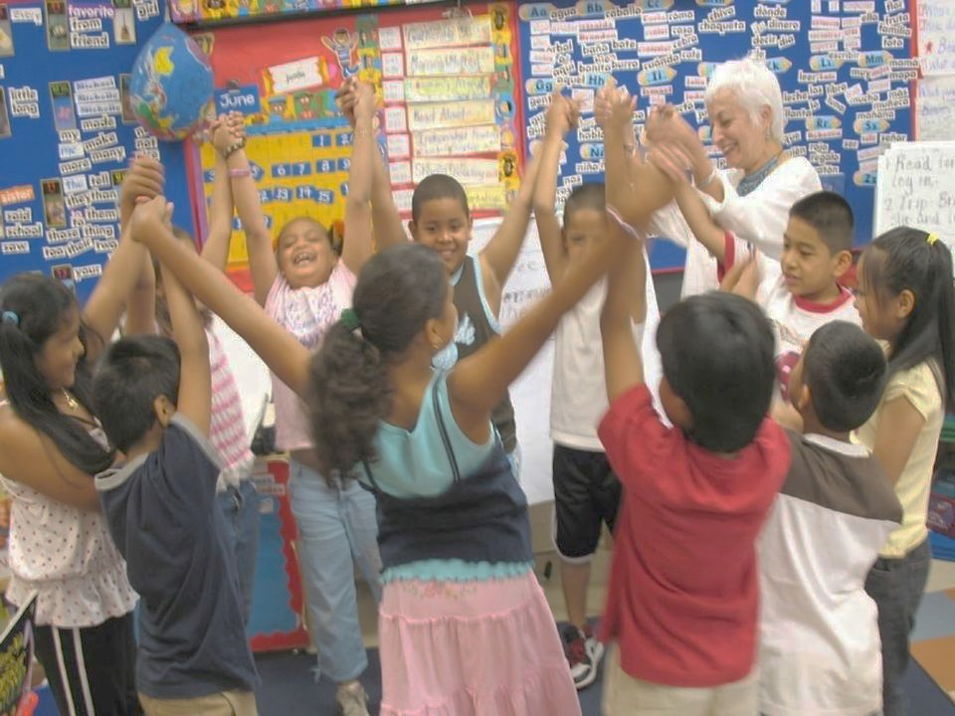
SEL is…
Social and emotional learning (SEL) is an integral part of education and human development. SEL is the process through which all young people and adults acquire and apply the knowledge, skills, and attitudes to develop healthy identities, manage emotions and achieve personal and collective goals, feel and show empathy for others, establish and maintain supportive relationships, and make responsible and caring decisions.
SEL advances educational equity and excellence through authentic center- or school-family-community partnerships to establish learning environments and experiences that feature trusting and collaborative relationships, rigorous and meaningful curriculum and instruction, and ongoing evaluation. SEL can help address various forms of inequity and empower young people and adults to co-create thriving centers and schools and contribute to safe, healthy, and just communities.
Notes:
1 min
Reground in definition of SEL. Which word(s) of the definition most stand out to you when you think about self-management and self-awareness?

Slide 7
Setting the stage for self-awareness and self-management
“Imagine a world where we intentionally taught children pro-social skills, gave them many opportunities to practice, and positively reinforced them every time they used those skills.”
As you watch this TedTalk from Dr. Rosemarie Allen, take notes on the following:
How are adults responsible for the teaching and modeling of self-awareness and self-management skills?
How do (or should) adults rely on their own social-emotional skills to support children?
Why is it essential to teach instead of punish?
Notes:
22 minutes
12 min. video
7 min. small group discussions (ask participants to identify a spokesperson for when we return whole group)
3 min. whole group share
https://www.youtube.com/watch?time_continue=182&v=f8nkcRMZKV4&feature=emb_logo
Dr. Rosemarie Allen

Slide 8
Connecting this work to the Pyramid Model
WE ARE HERE
Notes:
1 min
As we mentioned before, this training is not a TACSEI/Pyramid Model, but if you are using the Pyramid Model approach, it should strengthen/deepen your knowledge of how to build an effective workforce in your center and how to support teachers in building nurturing and responsive relationships and setting up high-quality supportive environments.

Slide 9
Agenda
Opening
Why Intentionally Build Social-Emotional Skills?
Understanding Self-Awareness and Self-Management
Developing Self-Awareness and Self-Management Skills
Application and Feedback
Closing
Notes:
1 min
Transition to the next section of the presentation.

Slide 10
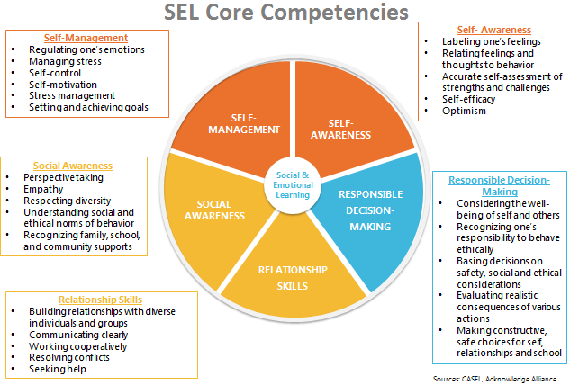
Revisiting the five Social-Emotional Competencies
Notes:
2 mins
BRIEFLY revisit to provide overview and framing for where we’re focusing today.
Share the overview of the framework we’ll be using for engaging with the competencies of SEL.
Today we’ll focus specifically on self-awareness and self-management, the intrapersonal competencies.
Intrapersonal competencies refer to ways of dealing with oneself, including ones’ thoughts and emotions. These
are the awareness, beliefs, and skills directed and applied inwardly.

Slide 11
What is self-awareness?
Includes:
Identifying emotions
Accurate self-perception
Recognizing strengths
Self-confidence
Self-efficacy
Identifying personal, cultural, and linguistic assets
Linking feelings, values, and thoughts
Having a growth mindset
Developing interests and a sense of purpose
The ability to accurately recognize one’s own emotions, thoughts, and values and how they influence behavior across contexts. The ability to accurately assess one’s strengths and limitations, with a well-grounded sense of confidence, optimism, and a “growth mindset.”
Notes:
8 mins.
4 for video
4 for discussion
SAY: We’re going to spend a couple of minutes learning a little bit more about each intrapersonal competency, starting with self-awareness.
It’s worth noting that intrapersonal competencies are separated based on AWARENESS (self-awareness) and SKILLS (self-management). What children need to know AND be able to do.
SAY: Let’s start by building our own knowledge on what we mean by self-awareness for children.
As you watch, jot down notes on anything that stands out for you during the video. Look especially for what are some of the key features of self-awareness, and why self-awareness skills are important throughout a child’s entire life.
PLAY full video (4 mins.) https://www.youtube.com/watch?v=dZL2eZBe4Ew&list=PLqSvevVI2ir-MthHDHyBhgEvWVsjgqbzO&index=1
ASK: What are some of the key features of self-awareness? Why is it important?
(Whole group share out)
ANIMATE slide for definition and key features

Slide 12
What is self-management?
Includes:
Impulse control
Stress management
Organizational skills
Managing one’s emotions
Identifying and using stress management strategies
Exhibiting self-discipline and self-motivation
Setting personal and collective goals
Showing the courage to take initiative
The ability to successfully regulate one’s emotions, thoughts, and behaviors in different situations — effectively managing stress, controlling impulses, and motivating oneself. The ability to set and work toward personal and academic goals.
Notes:
8 minutes
4 for video
4 for discussion
SAY: Now let’s take a closer look at the skills side of intrapersonal competencies, self-management.
As you watch, jot down notes on anything that stands out for you during the video. Look especially for what are some of the key features of self-management, and why self-management skills are important throughout a child’s entire life.
PLAY full video (4 mins.) https://www.youtube.com/watch?v=tXKFNDFjKwY&list=PLqSvevVI2ir-MthHDHyBhgEvWVsjgqbzO&index=4&t=0s
ASK: What are some of the key features of self-management? Why is it important?
(Whole group share out)
ANIMATE slide for definition and key features

Slide 13
How do our tools help us understand intrapersonal competency development?
Notes:
2 mins
Now that we understand self-awareness and self-management a little bit better, let’s see exactly what that means for the ages of the children that we support.
The Infant and Toddler Early Learning Guidelines and Pre-Kindergarten Standards are built to address the major developmental milestones that children should hit each year. They provide what every child should know and be able to do in order to be successful in the next grade level.
NOTE: These standards and guidelines are in the process of being revised by a team of partners across the state right now, so they *are* subject to change.
SAY: No matter your level of familiarity with the standards, they are always essential to grounding the work that we do each day with children. We are going to spend a lot of time with the guidelines and standards for social-emotional development in this series. We’ll be looking particularly at the Personal and Social/Emotional Domain, and the corresponding content standards listed within.

Slide 14
Using Guidelines and Standards to Map Intrapersonal Developmental Trajectories
Note: This is a Content Standard within the “Personal and Social/Emotional” Domain
Sample Developmental Trajectory of
Self-Awareness Behaviors
(from “Developing a Sense of Self and Others”)
Show happiness or distress in a variety of ways
Engages others by expressing feelings, needs, or wants verbally and/or non-verbally
Express a wide range of emotions including pride, shame, embarrassment, and guilt
Express feelings, needs, or wants appropriately with adult guidance
4 years
3 years
2 years
1 year
Sample milestones pulled from “Nevada Infant and Toddler Early Learning Guidelines” (2011) and “Nevada Pre-Kindergarten Standards” (2010)
Notes:
2 mins.
The Guidelines and Standards provide a helpful roadmap for early childhood teachers and leaders to understand what is developmentally appropriate for children in their schools and centers. Below shows one sample trajectory focused on a component of developing self-awareness from birth to four-years-old.

Slide 15
What should we expect to see in classrooms?
SELF-AWARENESS
GROUP 1 | GROUP 2 | GROUP 3 | GROUP 4 | GROUP 5
Birth-1 year | 1-2 years | 2-3 years | 3-4 years | 4-5 years*
SELF-MANAGEMENT
GROUP 6 | GROUP 7 | GROUP 8 | GROUP 9 | GROUP 10
Birth-1 year | 1-2 years | 2-3 years | 3-4 years | 4-5 years*
*If you are assigned to the 4-5 year age bracket, make sure you are using the NV Pre-K Standards (NOT the Infant-Toddler Guidelines)
Notes:
19 mins
In Session 1, we looked at the big picture of how all 5 competencies develop over time. In these more focused sessions, we are going to dive much deeper to look at how specific competencies develop each year. You’ll be looking at a much more narrow set of the guidelines/standards.
9 mins: Break into small groups assigned on slides to dive deeply into your age range using the guidelines or pre-k standards. Make sure to pay attention to your breakout room!
Based on what you see in the guidelines/standards, what child and teacher actions should you expect to see? What are some things you might hear children or teacher say? Input your ideas/notes into the shared Google doc
10 mins: In whole group, share out for 1 min.

Slide 16
Quick brain break!
Notes:
5 min. break

Slide 17
Identifying self-awareness and self-management: young toddlers
As you watch the video, take notes on the following:
Where do you see evidence of self-management and self-awareness in the video?
What do the children demonstrate? How does the teacher reinforce these skills?
Notes:
3 mins
1 min. for setup
2 mins. for video
SAY: Now we’re going to watch two video clips—one of a young toddler classroom, and one of a preschool classroom. Both clips are about 2 mins. long. As you watch, take notes on the questions on the slide. We’ll discuss both together after we watch the second clip.
https://www.youtube.com/watch?v=H2tX9spVgB4&feature=youtu.be

Slide 18
Identifying self-awareness and self-management: Preschool
As you watch the video, take notes on the following:
Where do you see evidence of self-management and self-awareness in the video?
What do the children demonstrate? How does the teacher reinforce these skills?
Notes:
6 mins
2 for video
4 for whole group discussion
https://www.youtube.com/watch?v=HnbYy0M88lM&feature=youtu.be

Slide 19
Reflection
What stands out to you most about the teaching and learning of self-awareness and self-management skills?
Notes:
4 minutes
Individual reflection

Slide 20
Agenda
Opening
Why Intentionally Build Social-Emotional Skills?
Understanding Self-Awareness and Self-Management
Developing Self-Awareness and Self-Management Skills
Application and Feedback
Closing
Notes:
1 min
Transition to the next section of the presentation.

Slide 21
We’ve talked about the “why” and the “what”. What about the “how”?
Notes:
2 minutes
Now that we have a deeper understanding of what the intrapersonal SEL competencies are, how they develop from birth to 5, and have seen some sample instruction, let’s dig further into how we can support that development in our classrooms.
Research has shown that social and emotional development can be fostered, and social and emotional skills, attitudes, and behaviors can be taught using a variety of approaches, primarily:
-Free-standing lessons designed to enhance children’s social and emotional competence explicitly.
-Teaching practices such as play-based, cooperative learning, and project-based learning, which promote SEL.
-Integration of SEL into content-based topics like language arts, math, social studies, or science.
-Organizational strategies that promote SEL as a school- or center-wide initiative that creates a climate and culture conducive to learning from the top down.
Graphic: https://casel.org/what-is-sel/approaches/

Slide 22
Social-emotional teaching
Explicit SEL Skills Instruction
Specific, planned activities for large or small groups of children to teach and practice a targeted social-emotional skill
Teacher Instructional Practices
Noticing and capitalizing on naturally occurring opportunities (“teachable moments”)
Promoting SEL through interactions and relationships
Integration with Academics
Reinforcing opportunities for SEL throughout the entire day
Intentionally planning for SEL practice during centers, reading and literacy, math, science, social studies, etc.
Organizational, Culture, and Climate Strategies
Center/school and classrooms are warm, inviting, and promote physical and emotional safety
Notes:
4 minutes
Children develop social and emotional skills primarily through interactions with parents, teachers, siblings, and peers. With many children spending large amounts of time in early education settings, the influences of early childhood teachers on children’s social and emotional learning is critically important.
Teachers promote social and emotional learning through a variety of activities and practices, some purposeful and planned, some naturally occurring.
Provide brief overview of best practices and approaches for social-emotional teaching
-Free-standing lessons designed to enhance children’s social and emotional competence explicitly.
-Teaching practices such as play-based, cooperative learning, and project-based learning, which promote SEL.
-Integration of SEL into content-based topics like language arts, math, social studies, or science.
-Organizational strategies that promote SEL as a school- or center-wide initiative that creates a climate and culture conducive to learning from the top down.
Note that there are likely many ways your teachers are already doing these things, whether consciously or unconsciously, and that’s great! We’re going to engage a little further to build on successes and practices that you and your teachers are already doing to boost that SEL learning, particularly through our lens this session of self-awareness and self-management.
https://www.naeyc.org/resources/pubs/yc/sep2018/becoming-a-social-emotional-teacher

Slide 23
Let’s take a look at some examples…
Explicit SEL Skills Instruction
Teacher Instructional Practices
Integration with Academics
Organizational, Culture, and Climate Strategies
Teachers have a “family tree” in their classroom, where they’ve posted pictures of each child’s family
Teachers plan a read aloud all about identifying and understanding emotions
A teacher notices two children pulling on the same toy. She intervenes to support the practice and language of sharing and taking turns.
Teachers act out how to calm down using songs and modeling with stuffed animals
Organizational, Culture, and Climate Strategies
Integration with Academics
Teacher Instructional Practices
Explicit SEL Skills Instruction
Notes:
4 minutes
Read each brief scenario and ask folks to share in the chat which type of SEL instruction is being highlighted.
ANIMATE after each example.
Note that these are the primary teaching strategies, BUT there could easily be more than one teaching approach per example. For example, #2 could also include “explicit SEL skills instruction” depending on how the read aloud is designed and executed.
The strength of these strategies is that they should always all be used in conjunction; teachers can’t rely on any 1 strategy—effective SEL instruction requires all 4.

Slide 24
Agenda
Opening
Why Intentionally Build Social-Emotional Skills?
Understanding Self-Awareness and Self-Management
Developing Self-Awareness and Self-Management Skills
Application and Feedback
Closing
Notes:
1 minute
Transition to the next section of the presentation.

Slide 25
Putting the Pieces Together: Planning
Self-Awareness & Self-Management
Explicit SEL Skills Instruction
Teacher Instructional Practices
Integration with Academics
Organizational, Culture, and Climate Strategies
Notes:
7 minutes (individual planning)
In your notes, revisit the key skills included in developing self-awareness and self-management, as well as the trajectory along which these skills develop.
Consider each social-emotional teaching strategy through the lens of teaching self-awareness and self-management. What could you do to effectively teach self-awareness and self-management using each teaching strategy?

Slide 26
Feedback
Self-Awareness & Self-Management
Explicit SEL Skills Instruction
Teacher Instructional Practices
Integration with Academics
Organizational, Culture, and Climate Strategies
In your small groups:
Share what you would plan to do using each teaching strategy to effectively teach self-awareness and self-management.
Name which ideas you have in common, which ideas are strongest, and which ideas may still need a little refinement to support the teaching of self-awareness and self-management.
Select your favorite ideas and share them in the group Google Doc.
Notes:
5 mins—small groups
3 mins—whole group share
Provide directions and split participants into groups of 2-3.

Slide 27
Reflection
Handouts, Page 11
What SEL teaching strategies do you already use reliably?
What strategies will you need to be more intentional in implementing?
Notes:
3 minutes
Individual reflection

Slide 28
Agenda
Opening
Why Intentionally Build Social-Emotional Skills?
Understanding Self-Awareness and Self-Management
Developing Self-Awareness and Self-Management Skills
Application and Feedback
Closing
Notes:
Transition to the next section of the presentation.

Slide 29
“What’s Learned Here, Leaves Here”
Handouts, Page 12
What are your biggest take-aways from this session?
How will you carry this learning forward in your own work?
Notes:
5 minutes

