Slide 1
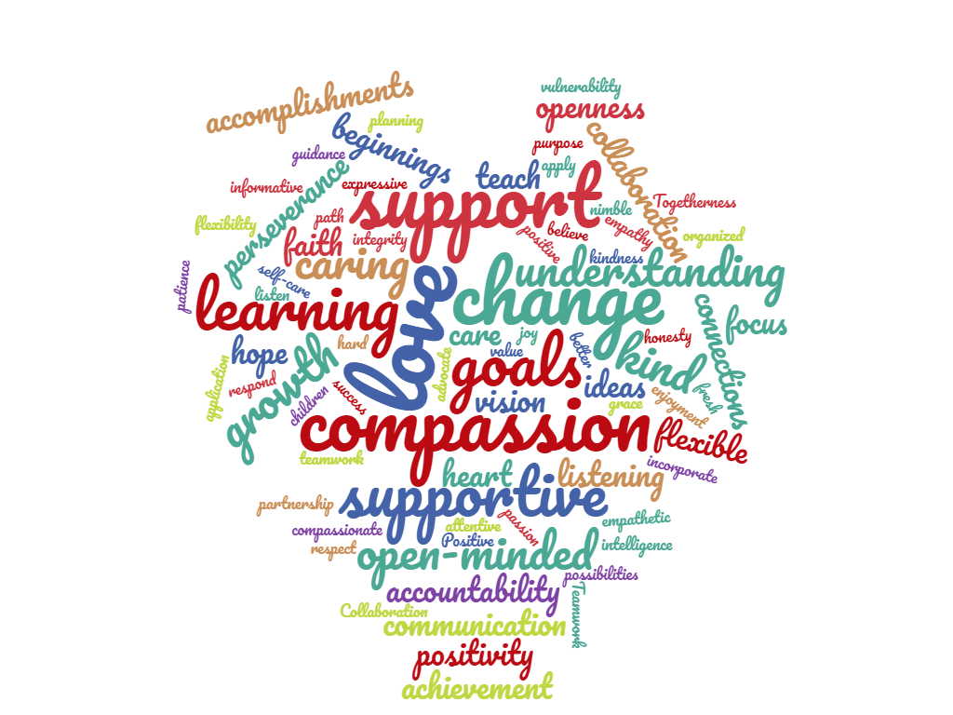
Do Now
Think about your own experience in coping with the new realities that have come with the coronavirus pandemic.
What emotional and physical responses have you experienced in the past four months?
How have you managed those responses? How have you relied on others to help you?
Notes:
3 mins.
Direct participants to complete their Do Now independently. Jot down ideas in their notes for now.

Slide 2
Trauma-Informed Teaching in ECE: Part 3
Nevada Early Childhood SEL Series
Session 3
Notes:
1 minute

Slide 3
Objectives
Understand how trauma affects adults, particularly adults who work with children
Reflect on how current events will likely affect adults and their behavior, and what that will mean for your work as a leader
Plan for how to support the social-emotional health of staff and self
Notes:
1 minute
Review the objectives and make additional connections about how today’s session will help participants in their schools and centers.
COLD CALL participants to read each of the objectives aloud.

Slide 4
Agenda
Opening
Understanding Trauma in Adults
Supporting Your Staff and Yourself
Plan and Closing
Notes:
1 minute
Provide an overview of the agenda, describing how you will meet the session objectives over the course of the session.

Slide 5
Revisiting the Do Now
Think about your own experience in coping with the new realities that have come with the coronavirus pandemic.
What emotional and physical responses have you experienced in the past four months?
How have you managed those responses? How have you relied on others to help you?
Notes:
4 mins.
Whole group discussion

Slide 6
Agenda
Opening
Understanding Trauma in Adults
Supporting Your Staff and Yourself
Plan and Closing
Notes:
1 minute
Provide an overview of the agenda, describing how you will meet the session objectives over the course of the session.

Slide 7
Understanding Trauma in Adults
Notes:
3 minutes
Play podcast (2 mins): https://tools.cdc.gov/podcasts/media/mp4/CopingTraumaticEvents_Pod.mp4
Supporting children who have experienced trauma and loss can be emotionally exhausting. Young children may not filter graphic details of their traumatic experiences and their expressions of grief can be particularly poignant. The empathy and genuine concern of early childhood educators may lead them to be more likely to experience vicarious traumatization or compassion fatigue. Early childhood educators often live in the same community as the children they care for and may be equally or more personally impacted by the crisis than the children.
https://developingchild.harvard.edu/resources/how-to-help-families-and-staff-build-resilience-during-the-covid-19-outbreak/

Slide 8
Managing Hardship in the Time of COVID
Notes:
2 mins
Resilience can help us get through and overcome hardship. But resilience is not something we’re born with—it’s built over time as the experiences we have interact with our unique, individual genetic makeup. That’s why we all respond to stress and adversity—like that from the COVID-19 pandemic—differently.
Think of resilience as a seesaw or balance scale, where negative experiences tip the scale toward bad outcomes, and positive experiences tip it toward good outcomes. For some people during the COVID-19 outbreak, the resilience scale may look like this.
The point where the scale balances is called the “fulcrum,” and if it is more to one side or the other, it can make it harder or easier to tip the resilience scale to the positive. Everyone’s fulcrum is in a different spot—which explains why each person is different in how easily we can counterbalance hardships in life. The good news is that the fulcrum can be moved by developing a toolkit of skills you can use to adapt and find solutions. (More on that later.)
https://developingchild.harvard.edu/resources/how-to-help-families-and-staff-build-resilience-during-the-covid-19-outbreak/

Slide 9
Unload the Negative Side
Helping meet basic needs by connecting them with programs that can help
Give teachers a break as possible, even for a few minutes at a time
Encouraging staff to practice self-care—and model it yourself!
Notes:
2 minutes
So, what can we do to build up and strengthen resilience right now during the COVID-19 outbreak? And how can we build resilience to plan ahead for future times of crisis?
The science of child development points to three ways we can affect experiences and the balance of the resilience scale:
We can lighten the load on the negative side of the resilience scale by reducing sources of stress for families and program staff. Reducing sources of stress may include:
Helping families meet basic needs like food, shelter, diapers, health care, child care, and internet access or connecting them with programs that can help
Give teachers a break, even for a few minutes at a time
Encouraging parents, program staff, and co-workers to practice self-care—even if it’s just taking a few minutes to themselves, going for a walk, or getting plenty of rest. Make sure staff are aware of and taking advantage of employee benefits such as employee assistance programs, mental health counseling, and paid time off.
https://developingchild.harvard.edu/resources/how-to-help-families-and-staff-build-resilience-during-the-covid-19-outbreak/

Slide 10
Load Up the Positive Side
Build responsive relationships with all staff and families
Maintain and encourage connections with family and friends
Continue to practice serve-and-return interactions
Provide and expect grace from one another
Notes:
2 minutes
We can add to the positive side of the resilience scale by piling on positive experiences—especially through responsive relationships. The one thing that most children who develop resilience have in common is a stable, committed relationship with a supportive parent, caregiver, or other adult. Adults need those supportive relationships, too!
If you work with families, you’ve likely already found new ways to check in with them while in-person visits aren’t possible—via phone calls or video chats, for example. The limitations of these alternatives may be a little frustrating, but remember that you’re not just checking in; you’re also providing parents with time to engage in a responsive relationship with a trusted adult during a time of physical isolation.
Maintain and encourage connections with family and friends. Even though we’re all required to maintain physical distance, it’s important to call, video chat, email, or write letters to the people we care about to engage in responsive interactions, protect our emotional well-being, and manage the stress of living through this challenging time. (And, please access outside help and resources if you or someone else needs it.)
Children’s development doesn’t pause during a crisis—and supporting that development and building resilience doesn’t have to take a lot of extra time or effort. Back-and-forth “serve and return” interactions are simple and free, and you can do them during ordinary moments throughout the day. If your baby makes a coo or gurgle during a diaper change, make a sound back. If your toddler points to something, point at it too and say what the object is. Playing with a child is a great way to engage in serve and return—and relieve some stress for all!
https://developingchild.harvard.edu/resources/how-to-help-families-and-staff-build-resilience-during-the-covid-19-outbreak/

Slide 11
Move the Fulcrum
Provide tools to support staff in managing executive function and self-regulation skills
Create step-by-step checklists for new school- or center-wide procedures, expectations, etc.
Connect with programs that support core life skills
Notes:
2 minutes
We can make it easier for a scale to tip toward positive outcomes by strengthening core life skills. All of us need executive function and self-regulation skills to manage daily life, but stress makes it more difficult to use the skills we have. During the COVID-19 pandemic, we need these core life skills for things like planning less frequent trips to the grocery store or market, filling out forms for relief funds or loans, navigating support programs, and for managing work, home, and caring for children. Adults can strengthen these skills with small but helpful supports, like:
Sending or signing up for text reminders of important appointments
Using tools such as grocery list apps, menu planners, and daily schedules (and posting them for the whole family to see)
Creating step-by-step checklists for accessing relief funds and filling out important applications
During a crisis like the COVID-19 outbreak, families need their immediate, basic needs met before they can focus on anything else. But, when the crisis is over, longer-term programs that support adults and children in building and practicing their core life skills will again be necessary and effective.
https://developingchild.harvard.edu/resources/how-to-help-families-and-staff-build-resilience-during-the-covid-19-outbreak/

Slide 12
Reflection
How can you apply the three previous principles to support yourself and your colleagues in managing hardship?
Notes:
3 mins.
Independent reflection

Slide 13
Agenda
Opening
Understanding Trauma in Adults
Supporting Your Staff and Yourself
Plan and Closing

Slide 14
Recognizing Common Symptoms of Stress
Feeling irritation, anger, or in denial
Taking care of personal and family needs while working
Adapting to a different workspace and/or work schedule
Physical reactions, such as headaches, body pains, stomach problems, and skin rashes
Changes in appetite, energy, and activity levels
Feeling uncertain, nervous, or anxious
Lacking motivation
Feeling tired, overwhelmed, or burned out
Feeling sad or depressed
Having trouble sleeping
Having trouble concentrating
Notes:
3 minutes
Being an early childhood educator can be both physically and mentally exhausting. Young children are whirlwinds of energy, exploring, experimenting, and making discoveries. They depend on you to put them first, meet their needs and help them attain their aspirations. At the same time, they bring joy as you see them mastering tasks, learning new concepts, and appreciating you for being such an important part of their lives. But there is no denying that they can drain you of energy and leave you feeling spent.
When you add trauma to the situation, the chances that you will sometimes feel overwhelmed and find it difficult to go on increase dramatically. Children who have experienced trauma often respond to it in ways that test your patience and push you to the limit. Children who are in survival mode can be aggressive, rude, uncooperative, and inattentive. And until you are able to help children feel calm and safe and learn to self-regulate, you cannot focus on other kinds of learning.
If you have endured the same traumatic experiences as the children—a natural disaster, school violence, or a national crisis such as the COVID-19 pandemic—you share similar fight-flight-freeze responses in your life. You may be dealing with issues like the loss of personal property or you may even be grieving the death or injury of a loved one.
In addition, like a number of early childhood educators, you may also be a survivor of your own childhood traumas, which may or may not have been resolved. Hearing of children’s experiences and fears can bring back unhappy memories that temporarily paralyze or haunt you.
https://emergency.cdc.gov/coping/selfcare.asp
https://www.cdc.gov/coronavirus/2019-ncov/community/mental-health-non-healthcare.html

Slide 15
Concrete Support Strategies
SOCIAL | EMOTIONAL
Cultivate and maintain supportive relationships with all staff members Plan for safe, socially-distanced face-to-face time Support managing personal and professional needs Find ways to stay connected to the community Connect staff to resources | Allow safe places to process emotions Air feelings and talk through problems Build in time for breaks Develop a professional support system Support practicing mindfulness across your school or center Give your staff (and yourself) grace as you move through this complex time
Notes:
3 mins
Support yourself and your colleagues in practicing self-care. Regularly using the ideas suggested here will help you and your staff heal from secondary stress and fortify you for the future.
https://emergency.cdc.gov/coping/selfcare.asp
https://www.cdc.gov/coronavirus/2019-ncov/community/mental-health-non-healthcare.html
https://www.naeyc.org/resources/pubs/yc/jul2020/preventing-compassion-fatigue

Slide 16
Agenda
Opening
Understanding Trauma in Adults
Supporting Your Staff and Yourself
Plan and Closing

Slide 17
Planning to Support Your Staff and Yourself
Spend the remainder of this session putting together a plan for how to support yourself in the midst of this crisis.
Notes:
11 minutes

