Slide 1
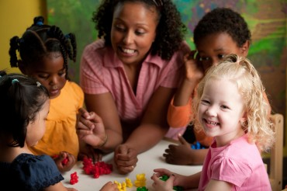
Do Now
Recall an important teacher in your own life. How would you describe the relationship? What made it feel like a partnership?
How do you build relationships across difference?
Notes:
4 mins.
Direct participants to complete their Do Now independently. Jot down ideas in their notes for now.

Slide 2
Culturally Responsive Teaching in ECE: Part 2
Nevada Early Childhood SEL Series
Session 5
Notes:
1 minute
Welcome participants to our second session on CRT. In our previous session we began to lay the foundation for Awareness, and built our understanding of the roots and levels of culture and how they impact a child’s experience in their classroom.
Today we will be regrounding in that foundation, and digging into building meaningful relationships with children to support them in achieving their fullest potential under less stress.

Slide 3
Objectives
Explain why Culturally-Responsive Teaching (CRT) is an essential framework for early childhood classrooms
Understand the principles of Culturally-Responsive Teaching, with particular focus on the Relationships component of the Ready for Rigor framework
Plan to lay the foundations for Meaningful Relationships in classrooms across your center
Notes:
1 minute
Review the objectives and make additional connections about how today’s session will help participants in their centers.
COLD CALL participants to read each of the objectives aloud.

Slide 4
Agenda
Opening
Why Culturally-Responsive Teaching?
Beginning with Meaningful Relationships
Plan and Closing
Notes:
1 minute
Provide an overview of the agenda, describing how you will meet the session objectives over the course of the session.

Slide 5
Do Now
Recall an important teacher in your own life. How would you describe the relationship? What made it feel like a partnership?
How do you build relationships across difference?
Notes:
5 mins.
Whole group share

Slide 6
Agenda
Opening
Why Culturally-Responsive Teaching?
Beginning with Meaningful Relationships
Plan and Closing
Notes:
Provide an overview of the agenda, describing how you will meet the session objectives over the course of the session.

Slide 7
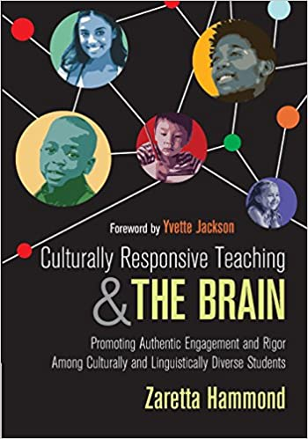
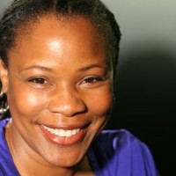
Start with Responsive
As you listen to the “blogcast”, respond to the following questions:
What is the “true starting point” for culturally-responsive teaching?
What are your major takeaways from this brief blogcast?
Notes:
18 minutes total
9 mins: blogcast
6 mins: small group breakouts
3 mins: whole group share
Play blogcast 1:00-end
https://crtandthebrain.com/start-with-responsive/

Slide 8
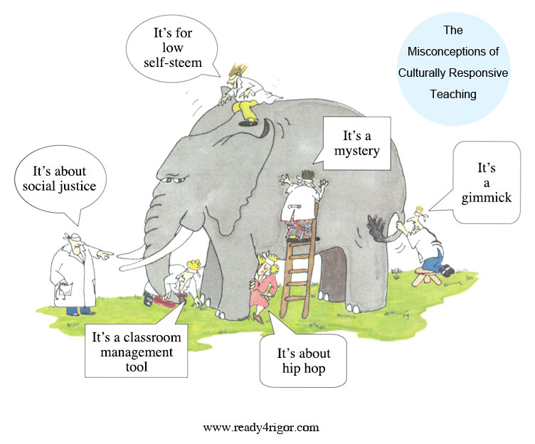
What is Culturally-Responsive Teaching?
“An educator’s ability to recognize students’ cultural displays of learning and meaning-making and respond positively and constructively with teaching moves that use cultural knowledge as a scaffold to connect what the student knows to new concepts and content in order to promote effective information processing. All the while, the educator understands the importance of being in relationship and having a social-emotional connection to the student in order to create a safe space for learning.”
Notes:
2 mins
Briefly revisit CRT definition from Part 1.
(original notes below)
When Zaretta Hammond opens her sessions on CRT, she asks groups to describe what CRT is. More often than not, every group emphasizes a different aspect of culturally responsive teaching that is a mix of truth and misconceptions. It’s like the story of the king who asked six blind men to tell them what an elephant was like. One felt his tail and said it was like a rope. Another had hold of a big floppy ear and likened the elephant to a fan. And so it went.
Well, that’s pretty much what it’s like hearing folks talk about culturally responsive teaching. In reality it isn’t a set of best practices, but a process.
Read the definition of CRT aloud.
Have participants enter key words/phrases into the chat

Slide 9
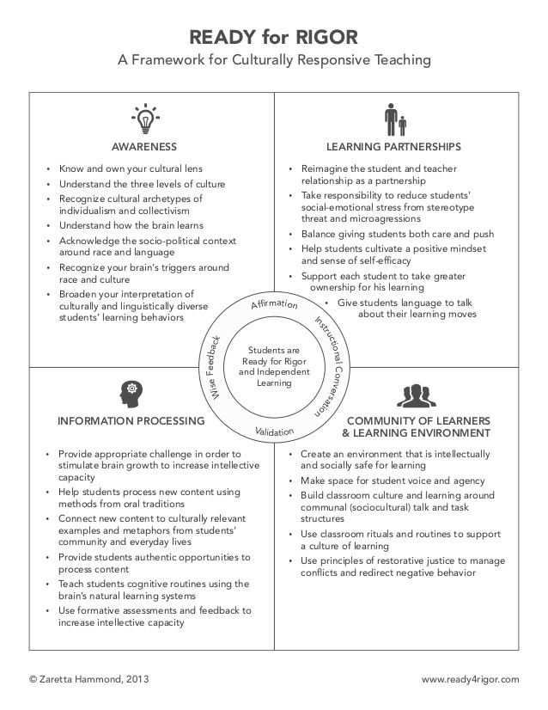
A Framework for Culturally-Responsive Teaching
Notes:
1 minutes
Briefly revisit the framework. Name that today we’ll be digging into the “Learning Partnerships” element.
(original notes below)
To best understand CRT, what educators need is a framework for organizing the process. The Ready for Rigor frame takes the key elements of cultural responsiveness and organizes them into four practice areas. Unlike the individual part of the elephant that is mistaken for the whole, each area of the frame is interdependent with the others. The social-emotional and cognitive aspects of teaching and learning show up in each area. At its core is the neuroscience that unifies the frame: the brain’s reaction to living in a racialized world as well as how it programs itself using culture.
Then there is the inner circle with the four staple practices of every culturally responsive teacher.
Affirmation – noticing and naming the unique talents and gifts of each child, especially those culturally grounded ways of being and expressing oneself.
Validation – acknowledging to children through word or deed the impact of unearned disadvantage in a racialized society without guilt or excuses.
Instructional Conversation — talking with children regularly about their learning process in order to move them safely into their zone of proximal development.
“Wise” Feedback – providing children with wise feedback, what Claude Steele says is the anecdote to stereotype threat. It is corrective feedback that first affirms the child‘s capacity to meet the goal or standard, tells him honestly where he missed the mark, gives him actionable steps to improve his learning, and helps him monitor his progress.
There’s no magic to the Ready for Rigor frame and it’s not the only culturally responsive frame out there. The real point is that you have to have some type of framework to make culturally responsiveness operational. The art of cultural responsiveness lies in weaving together these four practices areas into a process that calms the brain and sets the stage for neuroplasticity where the brain can grow itself.

Slide 10
Agenda
Opening
Why Culturally-Responsive Teaching?
Beginning with Meaningful Relationships
Plan and Closing
Notes:
Provide an overview of the agenda, describing how you will meet the session objectives over the course of the session.

Slide 11
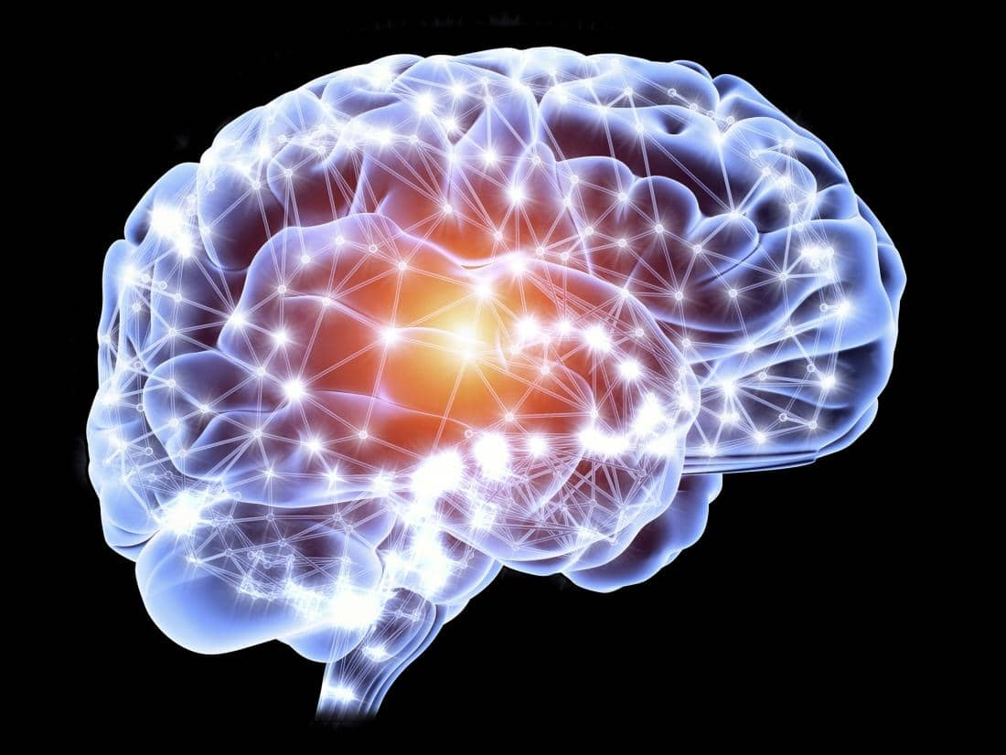
What does neuroscience tell us about trust and relationships?
TRUST→Oxytocin (“bonding hormone”)
This Photo by Unknown Author is licensed under CC BY-SA
Notes:
5 mins.
Name up front that the next few slides will be a bit of me talking to share information, then we’ll all do some exploration and integration of this content together.
The second practice area of the Ready for Rigor frame is focused on reframing and repositioning child-teacher relationships as the key ingredient in helping culturally and linguistically diverse learners authentically engage.
Why? In a collectivist, community-based culture, relationships are the founcation of all social and cognitive endeavors. All human beings are hardwired for relationships after living in communal, cooperative settings for millions of years.
At the core of positive relationships is trust. Caring is the way that we generate the trust that builds relationships. We have to not only care about children in a general sense, but also care for them in a physical and emotional sense.
Neuroscience tells us the brain feels safest and relaxed when we are connected to others we trust to treat us well. It responds to this connection by secreting oxytocin, called the bonding hormone. Oxytocin makes us want to build a trusting relationship with the other person we are interacting with. Simple gestures (a smile, nod of the head, pat on the back, etc.) from another person stimulates the release of oxytocin in the recipient.
More than that, researchers found that when individuals won the trust of another, their own brains responded by producing oxytocin—to make sure we connect with others, our brains developed “mirror neurons” to keep us in sync with each other. Mirror neurons encourage us to match our body language and facial expressions to the other person’s to signal trust and rapport. This synchronizing dance triggers our relaxation response, and we feel more trusting. The culturally responsive teacher uses thi sinformation to make a more personal and authentic connection with children across differences.

Slide 12
Rapport, Affirmation, and Validation
FEAR→Amygdala→Cortisol (“fight/flight/freeze”)
TRUST deactivates the amygdala.
Notes:
4 mins.
The only way to get children to open up to us is to show we authentically care about who they are, what they have to say, and how they feel. Caring within a culturally responsive context automatically places teachers in a different kind of emotional and academic partnership with children. This relationship is anchored in affirmation, mutual respect, and validation that breeds an unshakable belief that all our children, including our most marginalized, not only can but will learn and achieve to their fullest potential.
Rapport is generally defined as a sympathetic connection with another person that results in that warm, friendly feeling you get when you are in sync. In CRT, rapport is connected to the idea of affirmation.
Affirmation simply means that we acknowledge the personhood of our children through words and actions that say to them “I care about you”. Affirmation and rapport are about building trust. Trust and fear are inversely related; fear activates the amygdala and the release of cortisol, which triggers the fight, flight, or freeze responses, and stops all learning for about 20 minutes. Trust deactivates the amygdala and blocks the release of cortisol, therefore freeing up the brain for other activities like creativity, learning, and problem solving.
In the inner circle of the Ready for Rigor framework, affirmation and validation are two practices that undergird all efforts to operationalize rapport building. Affirming is simply acknowledging the personhood of each child, appreciating all aspects of them especially those culturally specific traits that have been negated by the dominant culture. Validation, on the other hand, is your explicit acknowledgement to children that you are aware of the inequities that impact their lives.

Slide 13
Building Trust and Rapport
Notes:
4 minutes
Feeling connected grows slowly and requires time for people to get to know each other. It happens in our small day-to-day interactions. Children begin to feel cared for when they recognize and experience familiar forms of affection and nurturing.
Wondering where to start? Trust begins with listening. The most powerful way to build rapport is by practicing what Reggio Emilia practitioners call a pedagogy of listening. Listening communicates a sense of respect for and an interest in the child’s contributions.
Research says that 70% of communication is nonverbal. Consider what this means for our youngest learners who are still making sense of the world! Listening doesn’t just mean hearing words that children are saying, but the emotional quality of the interaction. Even before we try to make a connection with children by being friendlier or sharing of ourselves, effective CRT practitioners start with listening. We need the kind of empathetic, attentive listening that builds rapport every day.
ASK: Many of us work with children who are not yet using words and sentences. What could empathetic, attentive listening look like with our youngest children?

Slide 14
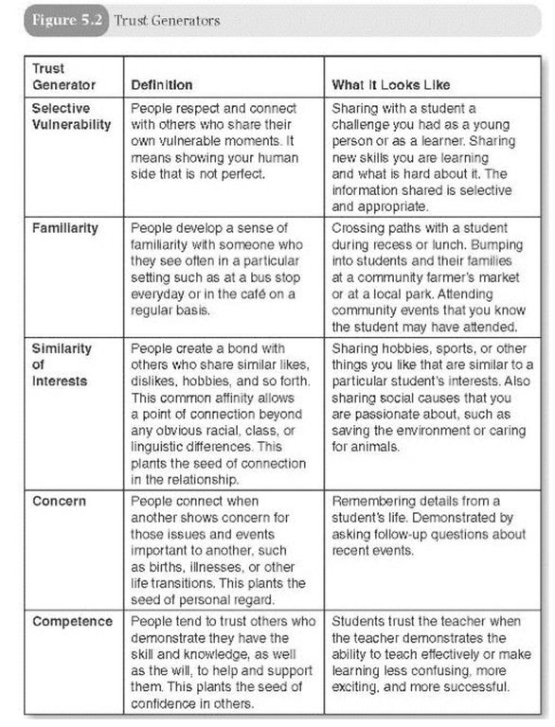
Trust Generators
Handouts, Page 14
Notes:
9 mins
5 mins—read and annotate
4 mins—which of these resonate with you most? Which have you used before? Which would be new to try?

Slide 15
Operationalizing Trust Generators
Selective Vulnerability in Action:
Tell your own story by weaving it into classroom stories/activities. What were you like as a child? What were your favorite things? What were some of your challenges? Bring in pictures of yourself as a child.
Share a new skill you are trying and learning—not the perfect ending, but the tricky beginning and middle parts.
Find common interests with children. Let children make connections that are meaningful to them.
Notes:
5 minutes
3 mins—examples of operationalizing selective vulnerability
2 mins—any additional ideas?

Slide 16
Reflection
How do you create a sense of trust and rapport in your relationships with children?
What do you do deliberately? What do you do randomly?
Notes:
6 mins.
Individual reflection

Slide 17
Agenda
Opening
Why Culturally-Responsive Teaching?
Beginning with Meaningful Relationships
Plan and Closing

Slide 18
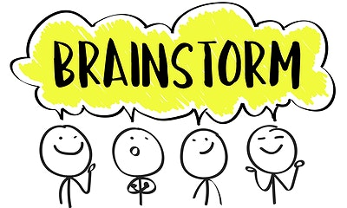
“My Points of Connection”
Take the next several minutes to brainstorm in the “My Points of Connection” worksheet.
Then, with your partner, share what you brainstormed and any “aha” moments you’re taking away from this exercise.
Notes:
16 minutes
7 mins—individual brainstorm
7 mins—partners
2 mins—whole group share

Slide 19
“What’s Learned Here, Leaves Here”
What are your biggest take-aways from this session?
How will you carry this learning forward in your own work?
Notes:
4 minutes

