Slide 1
Do Now
Reflect on any past equity or diversity training you have experienced in your adult life and career.
What insights and understandings about implicit bias are you bringing to your work as a culturally responsive educator?
Notes:
3 mins.
Direct participants to complete their Do Now independently. Jot down ideas in their notes for now.
Share that this is just a private reflection—we will not be sharing these experiences out.

Slide 2
Culturally Responsive Teaching in ECE: Part 3
Nevada Early Childhood SEL Series
Session 6
Notes:
1 minute
Welcome participants to our third session on CRT. We’re going to start to put together what we’ve learned about Awareness and Relationships to become actively culturally responsive practitioners.

Slide 3
Objectives
Review why Culturally-Responsive Teaching (CRT) is an essential framework for early childhood classrooms
Understand our own implicit biases, cultural reference points, triggers, and emotional self-management practices
Notes:
1 minute
Review the objectives and make additional connections about how today’s session will help participants in their centers.
COLD CALL participants to read each of the objectives aloud.

Slide 4
Agenda
Opening
Revisiting the Ready for Rigor Framework
Understanding Our Own Cultural Reference Points
Closing

Slide 5
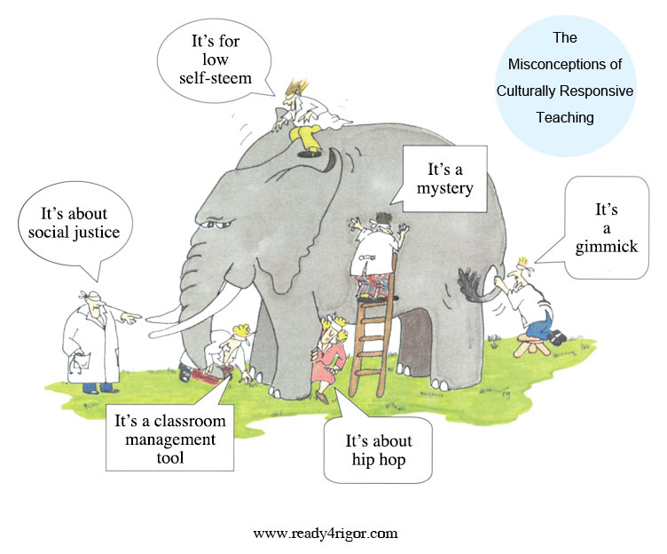
What is Culturally-Responsive Teaching?
“An educator’s ability to recognize students’ cultural displays of learning and meaning-making and respond positively and constructively with teaching moves that use cultural knowledge as a scaffold to connect what the student knows to new concepts and content in order to promote effective information processing. All the while, the educator understands the importance of being in relationship and having a social-emotional connection to the student in order to create a safe space for learning.”
Notes:
1 min
Briefly revisit CRT definition from Part 1.
(original notes below)
When Zaretta Hammond opens her sessions on CRT, she asks groups to describe what CRT is. More often than not, every group emphasizes a different aspect of culturally responsive teaching that is a mix of truth and misconceptions. It’s like the story of the king who asked six blind men to tell them what an elephant was like. One felt his tail and said it was like a rope. Another had hold of a big floppy ear and likened the elephant to a fan. And so it went.
Well, that’s pretty much what it’s like hearing folks talk about culturally responsive teaching. In reality it isn’t a set of best practices, but a process.
Read the definition of CRT aloud.
Have participants enter key words/phrases into the chat

Slide 6
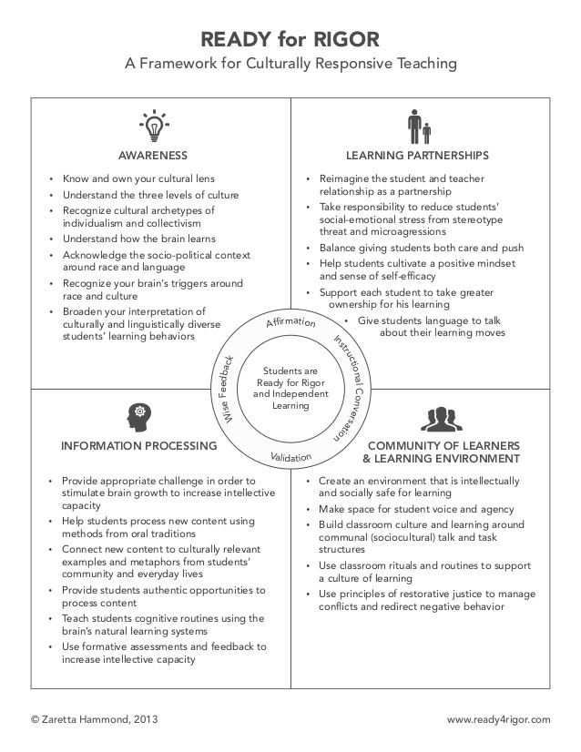
A Framework for Culturally-Responsive Teaching
Notes:
2 minutes
Briefly revisit the framework. Name that today we’ll be bridging some of what we’ve learned between Awareness and Learning Partnerships.
(original notes below)
To best understand CRT, what educators need is a framework for organizing the process. The Ready for Rigor frame takes the key elements of cultural responsiveness and organizes them into four practice areas. Unlike the individual part of the elephant that is mistaken for the whole, each area of the frame is interdependent with the others. The social-emotional and cognitive aspects of teaching and learning show up in each area. At its core is the neuroscience that unifies the frame: the brain’s reaction to living in a racialized world as well as how it programs itself using culture.
Then there is the inner circle with the four staple practices of every culturally responsive teacher.
Affirmation – noticing and naming the unique talents and gifts of each child, especially those culturally grounded ways of being and expressing oneself.
Validation – acknowledging to children through word or deed the impact of unearned disadvantage in a racialized society without guilt or excuses.
Instructional Conversation — talking with children regularly about their learning process in order to move them safely into their zone of proximal development.
“Wise” Feedback – providing children with wise feedback, what Claude Steele says is the anecdote to stereotype threat. It is corrective feedback that first affirms the child‘s capacity to meet the goal or standard, tells him honestly where he missed the mark, gives him actionable steps to improve his learning, and helps him monitor his progress.
There’s no magic to the Ready for Rigor frame and it’s not the only culturally responsive frame out there. The real point is that you have to have some type of framework to make culturally responsiveness operational. The art of cultural responsiveness lies in weaving together these four practices areas into a process that calms the brain and sets the stage for neuroplasticity where the brain can grow itself.

Slide 7
Agenda
Opening
Revisiting the Ready for Rigor Framework
Understanding Our Own Cultural Reference Points
Closing
Notes:
Provide an overview of the agenda, describing how you will meet the session objectives over the course of the session.

Slide 8
Unpacking our Implicit Bias
Begin with an Intention
Self-Examination: Making the Familiar Strange
Practicing Emotional Self-Management
“The real voyage of discovery consists not in seeking new landscapes, but in having new eyes.” Marcel Proust
Notes:
3 mins.
Today we’ll be shifting our thinking about CRT from culture and relationships to consider how we are shaped by our emotional intelligence and implicit biases.
Remember: CRT isn’t a set of engagement strategies—instead, think of it as a mindset, a way of looking at the world. Being responsive to diverse children’s needs asks teachers to be mindful and present ,and that requires reflection. Engaging in reflection helps us recognize the beliefs, behaviors, and practices that get in the way of our ability to respond constructively and positively to children. We must each do the “inside-out” work required: developing the right mindset, engaging in self-reflection, checking our implicit biases, practicing social-emotional awareness, and holding an inquiry stance regarding the impact of our interactions on children.
Today we’re going to uncover several strategies and tools for preparing ourselves to be emotionally conscious culturally-responsive educators. But before we can leverage diversity as an asset in the classroom, we must reflect on the challenges that can interfere with open acceptance of children who are different from us in background, race, class, language, gender, etc.
To become culturally responsive practitioners, we have to be willing to do the work of unpacking our implicit biases, even though that work can make us feel vulnerable or scared. That is the neurological response of our “lizard brains”, which is designed to keep us safe. If it could, our lizard brain would keep us deep in the center of our own comfort zone surrounded by a moat of our unconscious, implicit biases. When we try to venture beyond our own comfort zone (and therefore grow!), our lizard brain will flood our brain with stress hormones to short circuit our more rationale thourgh processes, and try to put us in freeze, fight, or flight mode. To identify and challenge our implicit biases, it’s essential to take a step back and recognize what is going on. We have to accept the challenge of venturing in to the unknown with an open mind and heart.
We are going to spend some time today digging into three steps that can help us move beyond our comfort zone and challenge the implicit biases that we unconsciously carry.

Slide 9
Begin with an Intention
“The journey of a thousand miles begins with a single step.” Lao Tzu
Notes:
2 mins.
Intention is the starting point for preparing yourself for improving your culturally responsive teaching practice. The act of committing to the process primes your brain and activates your will. The commitment to be an effective culturally responsive educator builds the stamin and courage to persevere when the process gets challenging.
Setting an intention for embarking on this work is personal. Take a moment now to jot down your intention in becoming a culturally responsive educator.

Slide 10
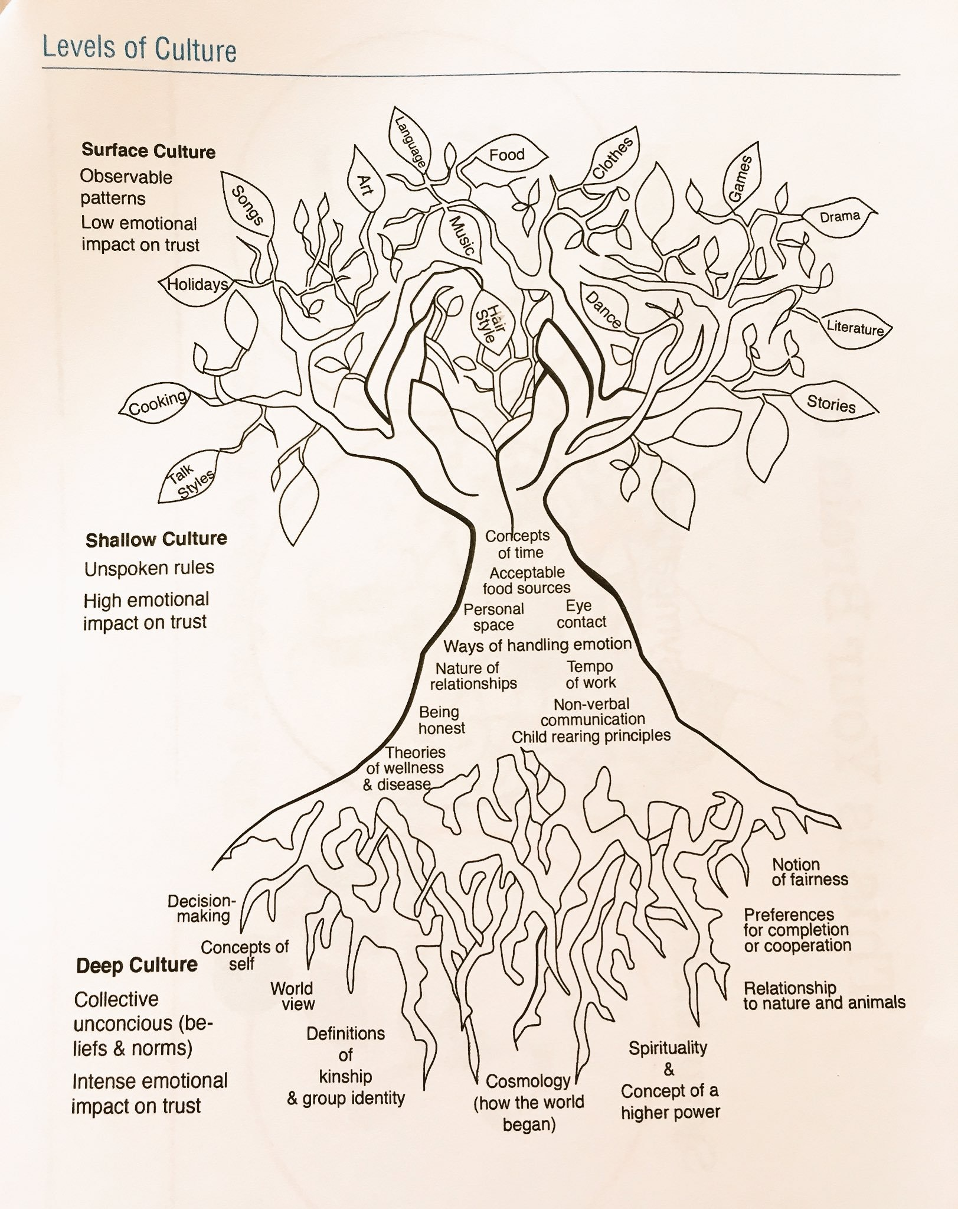
Self-Examination: Making the Familiar Strange
There are three internal tasks every educator has to work through to uncover implicit bias and prepare to work with culturally and linguistically diverse children.
Identify your cultural frame of reference
Widen your cultural aperture
Identify your key triggers
Notes:
2 mins.
The next stage is to examine our own cultural identities. Culture is like the air we breathe—it permeates all we do. And the hardest culture to examine is our own, because it shapes our actions in ways that seem invisible and “normal”. What feels normal to each of us is molded by deeply ingrained social habits and ways of valuing and evaluating what we’re barely aware of.
Learning about our own culture is far more challenging than learning about the culture of others. A critical first step is to understand how our own cultural values shape our expectations in our classrooms and centers—from how we expect children to engage socially, to turn-taking during conversations or activities, or even treating materials. Culturally responsive teaching asks us to take the emotional risk to examine the deeply held beliefs that influence how we respond to children—and that inward reflection means being willing to listen and change in order to respond positively and constructively to culturally diverse children.

Slide 11
Identify your cultural frames of reference
Notes:
9 minutes
2 mins—background knowledge
2 mins—read and highlight
5 mins—begin responding to questions
The first step in making the familiar strange is to take an inquiry stance towards your own cultural identity. If we want to be successful in our work with culturally and linguistically diverse children, we have to first accept and understand ourselves as cultural beings. This self-knowledge acts as a set of reference points that shape our mental models about teaching, learning, and our diverse children.
To identify our cultural frames of reference, we need to take the time to work through aspects of our own surface, shallow, and deep culture for clues about our own culture. Think of it as a treasure hunt. In your handouts, you’ll notice several questions to support you in mapping your cultural reference points. It’s important to set time aside to do the inquiry around these key questions, and we can’t try to answer them all in one sitting. We need to sit with these questions and give our brain time to sift through our memories.
Take the next few minutes to read through the questions in your handouts that help map your cultural reference points. Highlight the ones you want to tackle first, and spend a few minutes beginning to respond to 1-2 of those questions (but keep this going long after our session ends!)

Slide 12
Reflection
How will examining your own surface, shallow, and deep culture (using the questions provided in your handouts as a starting point) support you in understanding your own culture?
How will understanding your own culture make you a more effective culturally responsive educator?
Notes:
4 mins.
Individual reflection

Slide 13
Widen your interpretation aperture
Widen your interpretation aperture:
Broaden your body of explanations and interpretations of child actions
Develop a process that allows us to expand our ability to recognize the different ways things are done in other cultures
Let in alternative explanations for a child’s learning behaviors and social interactions that look different from our own
What is the deficit thinking paradigm?
When operating from a deficit thinking paradigm, educators and policymakers believe that culturally and linguistically diverse children fail in school because of their own deficiencies or because their families don’t value education, not because of social inequities, unfair systems, or differential treatment in the classroom. There is an ill-informed belief that a child’s failures are attributable to a lack of intellectual ability, linguistic inferiority, or family dysfunction. This deficit perspective suggests that efforts to improve achievement should be focused on “fixing” children rather than shifting the culture to support a child’s capacity building and creating identity-safe classrooms so that children can access their potential. As a result, teachers’ deficit-oriented attributions of child performance influence their decision-making, resulting in giving children less opportunity in the classroom.
Notes:
6 minutes
3 mins—description and reading of paradigm
3 mins—share in response to question
We’re going to cover these next two tasks briefly, because the most important step to truly understand and start on is what we just covered with understanding your own cultural frame of reference, but I do want to quickly highlight where we go from there, once we have mapped our cultural reference points.
Review highlights of widening your interpretation aperture. SAY: Many teachers don’t always think about the cultural lens that influences their interpretations of child actions, parent responses, or their own instructional styles. Instead, we fall back on our default programming which often leads to deficit thinking.
Ask participants to read the description of the deficit thinking paradigm.
ASK: It is our brain’s natural inclination to default to a deficit thinking paradigm (the brain’s “negativity bias”). How can widening our interpretation aperture prevent us from falling into that bias?

Slide 14
Identify your key triggers
Identify your key triggers:
Communicating across cultures opens up the potential for miscommunication and unintended conflict
When our brain’s alarm system gets triggered, we become culturally reactive in an effort to protect ourself rather than culturally responsive to the other person we are interacting with
Culturally responsive educators know themselves well enough to anticipate situations that might trigger them, and manage those emotions to avoid an amygdala hijack
Notes:
4 mins.
Highlight key components of identifying key triggers.
Call out that an important part of identifying your triggers is recognizing universal triggers that are hardwired into the brain. Research has shown that humans have a fundamental need to belong , are incredibly sensitive to their social context, and are strongly motivated to remain in good standing with their social group to avoid exclusion.
There are five elements of social interaction that activate strong threats and rewards in the brain, thus influencing how we react in given situations. They are standing, certainty, connection, control, and equity. They have a strong influence on our implicit bias and cultural frames of reference. These social interaction elements are outlined in your handouts—take a moment to read them through and reflect on which ones trigger you.

Slide 15
Practicing Emotional Self-Management
Identify what sets you off
Label your feelings when they come up
Create an “early warning system”
Notes:
2 mins.
Self-management involves being aware of one’s feelings and the ability to use this awareness as information to manage and adjust one’s emotional state—just like we ask children to do as they’re developing their own self-awareness and self-management! For a culturally responsive educator, this practice is critical.
Identify what sets you off: Think about—what makes you most defensive? By thinking this through in advance, you’re using your prefrontal cortex and programming it to keep your amygdala in check.
Label your feelings when they come up: Labeling these feelings helps reduce their intensity and returns some cognitive control. This process helps us reframe negative feelings, thereby reducing their impact.
Create an early warning system: By paying attention to signs and emotions you can take action early rather than allowing raw emotion to take over. Notice your physical reaction, and take the cue from your body to step back and regroup.

Slide 16
Reflection
What are some behaviors from children or families that might trigger you?
How can you identify those triggers to manage your own emotions and remain in a culturally responsive mindset?
Notes:
4 mins.
Individual reflection

Slide 17
Agenda
Opening
Revisiting the Ready for Rigor Framework
Understanding Our Own Cultural Reference Points
Closing

Slide 18
“What’s Learned Here, Leaves Here”
What are your biggest take-aways from this session?
How will you carry this learning forward in your own work?
How will this impact your work with the children in your classroom?
Notes:
12:44-12:48
4 minutes

