Slide 1
Do Now
Handouts, Page 1
“In four years, an average child in a professional family would accumulate experience with almost 45 million words, an average child in a working-class family 26 million words, and an average child in a welfare family 13 million words.”
For pre-work, you read “The Fight to Boost Student Literacy is Happening Years Too Late” by Conor Williams. Using your knowledge of that article and the quote above, respond to the following questions:
Why is it so urgent that our students are exposed to rich and varied vocabulary beginning from birth?
What are you and your teachers already doing to promote language acquisition in your students? Where do you wish you were doing more?
Notes:
5 minutes
Direct participants to share their answers with an elbow partner for 2 minutes, then share out whole group for 3 mins.

Slide 2
Building Oral Language: Promoting Complex Vocabulary Using Self- and Parallel-Talk
Notes:
1 minute
Welcome participants to the session. Express excitement for beginning training work together in support of our youngest learners. SAY: This morning we spent a lot of time talking about how to rate teachers, focusing especially on the Building Oral Language Skills competency. Once we’ve rated our teachers, we need to know what we can do to support their development in that competency. In this session, we are going to talk specifically about how teachers can build their students’ oral language skills, by using self- and parallel-talk to promote complex vocabulary.
Headline: Early childhood students need constant exposure to high-quality and varied vocabulary. The achievement gap truly starts with the language gap—many of our students start behind, and for them to be prepared to read and comprehend on grade level by 3rd grade, it is essential that we start with pushing in complex vocabulary at every opportunity.

Slide 3
Objectives
Explain why oral language development in young children is essential to their academic success
Understand the trajectory of oral language development as outlined in the research, the Infant and Toddler Early Learning Guidelines, and the Pre-Kindergarten Standards
Describe the principles of using complex vocabulary, self-talk, and parallel-talk in birth-five year old classrooms
Practice applying self-talk and parallel-talk strategies during instructional and non-instructional time
Plan for common opportunities to utilize self-talk and parallel-talk throughout the day
Notes:
1 minute
Review the objectives and make additional connections about how today’s session will help participants in their classrooms.
COLD CALL participants to read each of the objectives aloud.

Slide 4
Agenda
Opening
Why Oral Language?
The Trajectory of Oral Language Development
Developing Complex Vocabulary: Strategies, Practice, and Planning
Closing
Notes:
1 minute
Provide an overview of the agenda, describing how you will meet the session objectives over the course of the session.

Slide 5
Returning to the Do Now
Handouts, Page 1
“In four years, an average child in a professional family would accumulate experience with almost 45 million words, an average child in a working-class family 26 million words, and an average child in a welfare family 13 million words.”
For pre-work, you read “The Fight to Boost Student Literacy is Happening Years Too Late” by Conor Williams. Using your knowledge of that article and the quote above, respond to the following questions:
Why is it so urgent that our students are exposed to rich and varied vocabulary beginning from birth?
What are you and your teachers already doing to promote language acquisition in your students? Where do you wish you were doing more?
Notes:
5 minutes
Direct participants to share their answers with an elbow partner for 2 minutes, then share out whole group for 3 mins.

Slide 6
Agenda
Opening
Why Oral Language?
The Trajectory of Oral Language Development
Developing Complex Vocabulary: Strategies, Practice, and Planning
Closing
Notes:
1 minute
Transition to the next section of the presentation.

Slide 7
Imprisoned by Illiteracy
Handouts, Page 2
What are the effects of the 30 million word gap as students go through their academic experience?
What are your initial reactions to the presentation?
What does this mean that many of our children are up against?
Notes:
10 mins.
Presentation Link: https://www.atlantaspeechschool.org/Customized/uploads/Flash%20Pieces/Break%20the%20Cycle/RotaryPresentation.swf
5 mins: Walk through the presentation (up to the slide where the presentation starts talking specifically about the Rollins center)
5 mins: Give teachers time to talk through the questions on the slide. 3 mins—at tables. 3 mins—share out.

Slide 8
What Can We Do About It?
Handouts, Page 2
Key Idea:
Having conversations with students is one of the main ways to develop oral language. The majority of unstructured time in the classroom should be spent talking with children, focusing on their interests and their lives, NOT on behavioral corrections.
What can be done at the school, center, and classroom level to break this cycle of illiteracy?
Notes:
4 minutes
Share with the people at your group: what do you think we can do to break the cycle of poverty through literacy?
Listen for (and call out if you don’t hear):
We believe that language development is fundamentally important in ECE and provides the foundation for future comprehension development and learning in all content areas
We believe that having conversations with students is one of the main ways in which we will develop students’ oral language
You are able to proactively prepare your time and materials, and follow through on that preparation, such that the majority of unstructured time, including meals, centers, outdoor time, etc., is spent talking with children.
Teacher-student interactions are immensely important, and should focus around student interests and their lives, NOT behavioral corrections

Slide 9
Agenda
Opening
Why Oral Language?
The Trajectory of Oral Language Development
Developing Complex Vocabulary: Strategies, Practice, and Planning
Closing
Notes:
1 minute
Transition to the next section of the agenda.

Slide 10
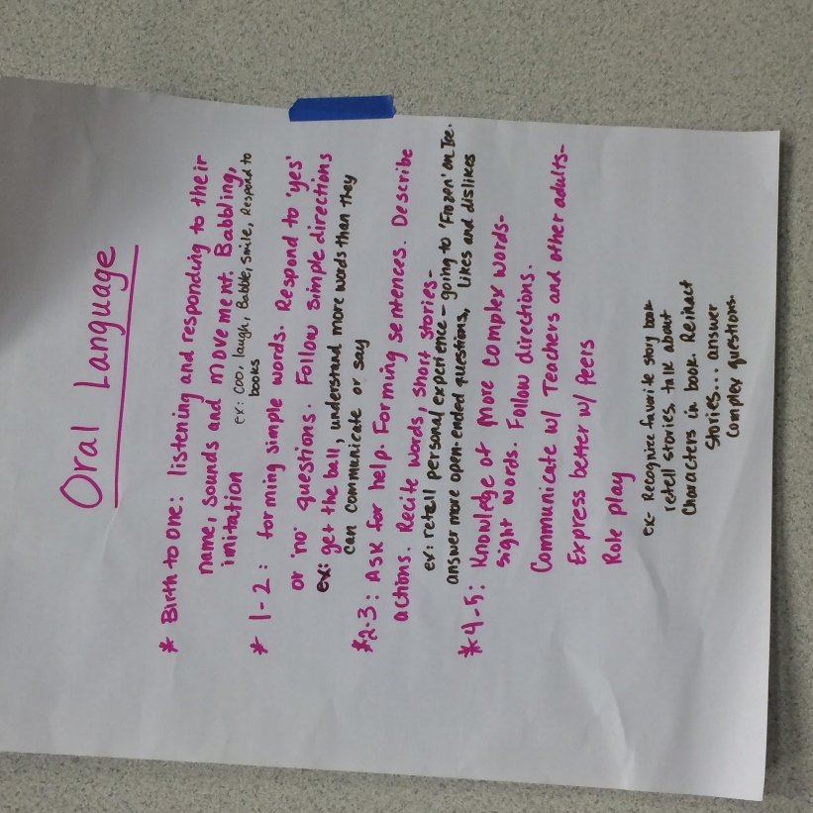
Returning to Standards and Developmental Trajectories
Handouts, Page 3
Key Idea
Students develop along predictable trajectories, more or less hitting milestones in a specific order and in specific age ranges. The Infant and Toddler Early Learning Guidelines and Pre-Kindergarten Standards are built to address the major developmental milestones that students should hit each year.
Notes:
2 minutes
COLD CALL a participant to read the key idea aloud.
SAY: These concepts should sound familiar to our last session! It is essential that we ground all of the work we do in the standards, so we can understand what is developmentally appropriate and make sure students are hitting the milestones they need to hit.
ASK: Who can remind us why using the standards are so important? Why will this help us understand the development of student oral language?

Slide 11
Understanding Oral Language in the Standards
Handouts, Page 3
Spend several minutes independently reading the Oral Language standards and Vocabulary standards in the Infant and Toddler Guidelines and the Pre-Kindergarten Standards.
Highlight any standards you notice that pertain specifically to vocabulary acquisition and development across the ages.
Map the major milestones that students will hit at each age (relating specifically to oral language and vocabulary) in your handouts.
Be prepared to share your takeaways!
Directions
Notes:
3 minutes
Provide voiceover of how this activity could be used with teachers.
When facilitating to teachers:
Explain the directions on the slide.
Provide participants 8 minutes to read—circulate and provide support where necessary.
Call group back together. ASK: What are your take-aways when looking at the progression of language and vocabulary development from birth through four?

Slide 12
Reflecting on the Developmental Trajectories
How will understanding the oral language milestones support your teachers in promoting language and vocabulary?
Notes:
4 minutes
Have participants discuss the two questions on the slide with an elbow partner for 2 minutes. Take 2 minutes for participants to share out. (if short on time, skip this slide)

Slide 13
Agenda
Opening
Why Oral Language?
The Trajectory of Oral Language Development
Developing Complex Vocabulary: Strategies, Practice, and Planning
Closing
Notes:
1 minute
Transition to the next section of the agenda.

Slide 14
Three Key Literacy Experiences for ECE Students
Handouts, Page 4
Opportunities to be part of conversations that include extended discourse
Exposure to varied vocabulary
Key Literacy Experiences
An environment that is cognitively and linguistically stimulating (including books and curriculum)
Notes:
3 minutes
In “Fostering Language and Literacy in Classrooms and Homes”, David Dickinson (2004) identifies the three key literacy experiences in Early Childhood classrooms that are most heavily linked to later literacy success. We are going to be digging deeply into all three of these over the course of the Leadership Series. For this session, we will be thinking specifically about the first pillar, “exposure to varied vocabulary”. This will be a theme that also connects all of the teacher sessions we will dig into over the course of this series.
ASK: Where do these three experiences resonate with you?

Slide 15
What do we mean by developing “complex vocabulary”?
Handouts, Page 4
Tier 3
Tier 2
Tier 1
Sophisticated words used frequently in texts and across many content areas
Basic words used frequently; usually don’t require explicit instruction
Uncommon words
Usually associated with a specific subject area
Children should know these before entering school
Examples: dog, cat, girl, boy, happy, sad, blue, jump
Examples: photosynthesis, anion, circumference
Contributes to most students’ knowledge when they transition from learning to read to reading to learn
Examples: discover, solution
Notes:
5 minutes
SAY: Today, we are going to dig deeply into the exposure to varied vocabulary as we develop these key literacy experiences for our students. By varied vocabulary what we mean is complex, high-quality words.
ASK: Has anyone seen this hierarchy of language triangle before? Can someone summarize what it outlines?
CONNECT back to the 30 million word gap. We know that it’s not only the quantity of words holding our students back, but even more importantly the QUALITY of words that students are exposed to. That’s why we focus so closely on the Tier 2 vocabulary—these are high-quality, high-utility words that will contribute most to student comprehension when they begin reading to learn.
Tier 1- children should know these before entering school; basic words used frequently; usually don’t require explicit instruction
Tier 2- sophisticated words used frequently in texts and across many content areas; this helps children understand what they read when they get to 3rd grade and beyond; contributes to most students’ knowledge when they transition from learning to read to reading to learn
Tier 3- Uncommon words; Usually associated with a specific subject area (i.e.. photosynthesis, anion, circumference)
Tier II words are those high-utility words that mature readers, writers, and speakers know and use. These are words that your students probably do not have in their vocabulary unless we use them on a daily basis.
TAKE out list of Tier 2 Vocabulary word handout.
SAY: The Atlanta Speech School that compiled this vocabulary research, created this list of Tier 2 vocab words pulled from third-grade reading level text. The implication here is that if you can push these words into your students’ expressive vocabularies, then when they read them on paper in third grade they will already know what they mean and be able to comprehend the text. Focusing on phonics (HOW to read) is an extremely important start, especially in ECE, but it is not enough to prepare our students to be successful, fluent readers who comprehend later in life. While this list is of course not exhaustive, it is a helpful tool. There is significant research done around the quality of the words we use, and though we didn’t have time to dig into a particularly helpful article in our session today, I will include it in the Dropbox resources.

Slide 16
Selecting the Right Tier 2 Vocabulary
Handouts, Pages 5-6
Key Idea:
Exposing students to complex vocabulary should happen consistently throughout the day. It’s not enough, however, to incorporate complex language without intentionality. It’s essential that we expose our students to the right complex vocabulary.
IS IT USEFUL AND IMPORTANT?
Will they see or hear the word often?
CAN IT BE TAUGHT?
Can you teach the word in a way that children will understand?
WILL IT HELP TEACH IDEAS?
Do I have a variety of different kinds of words (nouns, adjectives, verbs, adverbs) that will expand student vocabulary in a variety of contexts?
DO YOU HAVE VARIETY?
Will understanding this word help them be able to express themselves or to understand what others are saying?
Will it help them comprehend a text that we are reading?
Are you able to define the word using other words/text/ movement/ pictures that children can understand?
Is this connected to a current theme or big idea we are working on in our classroom?
Will this help students make sense of the larger world?
Notes:
7 mins
TAKE out list of Tier 2 Vocabulary word handout. Briefly review how to choose the right Tier 2 vocabulary (outlined on slide).
Take 5 minutes to review the Tier 2 Vocabulary list and highlight 5-10 words that you would want teachers to promote (and students to know and use) that align to your vision for your center. Use the guiding questions on the slide to choose strong examples
Take 1 minute to share what you and why highlighted with a neighbor.
Cold call participants to share some of their words.

Slide 17
Promoting the Acquisition of Complex Vocabulary
Handouts, Page 7
Key Idea
Complex language needs to be intentionally incorporated into every interaction students have with adults in their classrooms.
STRATEGIES | DEFINITIONS
SELF-TALK | Talk about what you are doing, seeing, eating, touching, or thinking constantly throughout the day when working or conversing with students. In other words, narrate your actions, incorporating complex vocabulary throughout.
PARALLEL-TALK | Talk about what your student or students are doing, seeing, eating, or touching. In other words, narrate what they are doing, incorporating complex vocabulary throughout.
As we watch this video of a young toddler classroom, watch specifically for where you see the teacher use self- and parallel-talk, and what vocabulary she might be emphasizing.
Notes:
8 minutes
2 mins. to define the terms, 3 min. for video, 3 mins. to call out what teacher was doing well
Video Link: https://vimeo.com/171096546
SAY: Now that we know what types of words to push into our students’ learning experiences, we need to know how to do it strategically and effectively! Two strategies that are crucial are self-talk and parallel-talk.
ASK: What do you already know about these strategies?
Highlight the key parts of the strategies—mostly that it’s a lot of narration of teacher and student actions, and that complex vocabulary should be pushed into those narrations.
SAY: This is the same video we watched in the first session. When we rewatch high quality videos through a slightly different lens, we are able to pull out even more high-quality practice. When watching, look for the vocabulary this teacher uses, the quantity of narration, and where you specifically see self- and parallel-talk.
Show video.
ASK: What did you notice about the quantity and quality of language in this video? Where did you see self- and parallel-talk? Did the teacher choose language that was useful, important, and met the overall criteria for effective complex vocabulary?

Slide 18
Getting Ready to PRACTICE!
Key Elements of Practice
There will always be guided planning time so you don’t go into a practice “cold”. Facilitators will always provide a model for practice in advance so you can see exactly how the activity works and ask questions. Clearly defined roles (i.e.. 1 teacher, 2 students), expectations for each role, and opportunities to be in each role. Opportunities for feedback, re-practicing, and reflection. “Cheat Sheets” of look-fors to guide planning, practice, and feedback.
Common Pitfalls to Avoid
Slipping in and out of your role—practicing authentically in your true “leader voice” is essential to taking the practice seriously and getting the most value out of practice. Providing way too much feedback. Stick to one glow and one grow, and use the language of the feedback cheat sheets. If you finish before the facilitator calls time, practice again! The more practice you get, the more you will internalize the strategy or technique.
Notes:
4 mins.
SAY: During our next activity, we are finally going to get to do one of the most important things when learning and improving a new skill: PRACTICE! Throughout this series, there will be opportunities for practice in almost every teacher and leader session. It is an essential component of our training and learning model, because we know that hearing and seeing descriptions of techniques are only half of the learning experiences. To truly internalize and understand a technique, it requires practice, feedback, and re-practice opportunities.
Other professions, like doctors/lawyers/athletes, already know and emphasize the importance of practice. They use lots of off-stage opportunities for practice to make sure they perfect their craft, and teachers/leaders can and should do the same.
DIRECT attention to the slide. Talk through the key elements and common pitfalls.

Slide 19
Practicing Self- and Parallel-Talk
Handouts, Pages 8-9
Plan
Imagine you are popping into a two-, three-, or four-year-old classroom during center time. Students are engaged in a writing center, a library center, and a science center.
Write one parallel-talk sentence and one self-talk sentence that you could use with students in each center.
Practice
With the person sitting next to you, practice delivering your sentences as though one of you is the leader and the other is the student.
Feedback
After the leader practices their self- and parallel-talk sentences, the student will provide feedback (one glow, one grow) to the leader using the self- and parallel-talk cheat sheets.
After providing feedback, the roles will switch and the other partner will become the leader.
If you are the leader, you will practice delivering your self- and parallel-talk sentences to your “student” as though you are in the centers. If you are the student, you will silently pretend to be playing and working alongside the leader.
Notes:
12 mins
(4 to introduce practice, 1 to explain directions, 3 mins. to plan, 2 to model, 2 mins to practice, 1 min feedback, 2 mins practice, 1 min feedback)
EXPLAIN the directions for this activity. Use the guidance on the slide.
Provide 3 minutes for participants to plan.
MODEL how the practice will work. (Facilitator 1) will be the leader, (Facilitator 2/prepped participant) will be the student and provide feedback.
Model:
ACTION!
Teacher: For this practice, you will pretend to be in the writing center. (ACTION)
(“Student” begins mock-writing)
Teacher: ________, I really notice how hard you are concentrating on writing in your journal this morning! You are really focused on your work! I am going to join you, so I’ll select my pencil and journal and start carefully forming my picture just like you are!
(SCENE)
Student transitions from student to coach.
Coach: Great job narrating your actions and the students actions with some Tier 2 vocabulary, like concentrating, notice, forming, and select. Next time try using complex vocabulary from different word groups—you only used verbs, so try adding in some adjectives, nouns, etc.
As teachers practice, circulate. If there’s a piece of group feedback, feel free to pause practice, provide feedback, and then restart.
After the practice, ASK: How did that first practice feel? How do you see this being a valuable strategy when turn keying this session to your staff?

Slide 20
Reflecting on Practice
Discuss the following questions with your group:
How could this quick practice activity support you in gaining comfort and confidence using self- and parallel-talk?
How can you use self- and parallel-talk to promote complex vocabulary in their classrooms?
Notes:
5 mins—discuss in groups
5 mins—share out whole group

Slide 21
Overcoming the Get It-Do It Gap
Handouts, Page 10
The Get It-Do It Gap refers to the difference between cognitively understanding something and actually putting it into practice successfully.
What can we do or put in place to ensure that teachers not only understand the importance of promoting complex vocabulary constantly throughout the day, but actually follow through in doing it?
What can we do or put in place to ensure teachers are using self- and parallel-talk as key strategies to teach complex vocabulary?
Post lists in their own classrooms or hallways of Tier 2 vocabulary they are intentionally promoting. These lists can grow or rotate throughout the year. (Sharing these lists is a great way to also involve families!)
Post prompts in key areas—over the changing table, lunch area, centers—to remind themselves to use these strategies. Include sentence starters like “Right now I’m doing…” and/or “I can see that you are doing…”
Notes:
4 mins.
NOTE: This slide is animated.
Explain the Get It-Do It gap. Whole group: ask for responses to the questions on the slide.
ANIMATE some of our own suggestions before changing the slide.

Slide 22
Agenda
Opening
Why Oral Language?
The Trajectory of Oral Language Development
Developing Complex Vocabulary: Strategies, Practice, and Planning
Closing
Notes:
1 minute
Transition to the next section of the agenda.

Slide 23
Exit Ticket
What are your next steps for ensuring that you are constantly and intentionally exposing your students to complex vocabulary?
When and where will you increase your use of self- and parallel-talk? How will you hold yourself accountable for using these strategies?
What questions do you still have about what you learned today?
What feedback do you have about the session for the facilitator?
Next Steps for Teachers
Draft sentence starters that will help you remember to use these strategies daily. Post these prompts around your classroom strategically.
Select and post 10-15 complex vocabulary words that you want to emphasize over the next month.
Have your prompts and vocabulary posted by PROVIDE DATE.
Notes:
1 minute
Show this slide as just the sample for how to end the session with their staff
Direct participants to complete their Exit Ticket. Note that they should respond to the questions in their packet (will be the questions on the slide, but framed for leaders) and that this slide outlines what questions and expectations should be for their teachers.

