Slide 1
Building Math Skills – Math in its “Natural Environment” and STEM
Nevada Early Childhood Leadership Series
Session 5

Slide 2
Objectives
Articulate the connection with STEM to young children’s future math success
Understand and describe what STEM concepts are and how math exists in the “world around us”
Plan for and identify opportunities to connect math, science, and the world around us
Practice building students’ math skills in STEM-based centers and as part of exploring/understanding the world around us

Slide 3
Agenda
Opening
Why STEM?
Engineering and Technology
Science
Deep Dive: STEM in Action
Application: Plan and Practice
Closing

Slide 4
Why STEM?
Handouts, Page 2
“Understanding the world around them is one of the strongest predictors of young children’s later science learning and reading, and a significant predictor of mathematics success.”
--Grissmer, et. al., Developmental Psychology, 2010
Photo source: http://www.carnegiesciencecenter.org/images/page_main/early-childhood-stem-center_1.jpg
Notes:
Come back to the Do Now and have participants share out a few things they discussed.
Some great review/talking points to highlight if they are not covered by the group when they share out from this statement from the White House in 2016: https://obamawhitehouse.archives.gov/blog/2016/03/01/supporting-our-youngest-innovators-stem-starts-early
“Why?” “How?” One of the greatest joys of being a parent is the incredible curiosity children have for the world. Children are naturally inquisitive and they observe, investigate, and discover the world around them. The years from birth to third grade are filled with play and active engagement with the environment. They generate an endless number of questions, and their curiosity fuels their motivation to find answers. These are the traits we expect of our best scientists and engineers, yet many children lose the sense of wonder for science, technology, math and engineering (STEM) as they grow older.
Research indicates that as early as infancy, young children start developing and testing hypotheses for how the world around them works. They understand probability and make predictions. They take in information from trusted sources around them, and use that information to guide their behavior. And that all begins in the first year of life. As they progress through the preschool years, their curiosity continues to grow, and the sophistication of their reasoning and inquiry skills, grow along with it.
Too often, we underestimate the concepts our youngest learners can understand. As the most important influencers in our children’s lives, we -- whether parents or other caregivers, child care providers, preschool or elementary school teachers -- should support this curiosity, guide young children in their exploration, and identify natural learning opportunities to develop and grow these foundational STEM skills.
We know focusing on STEM pays off. Research shows that early exposure to STEM has positive impacts across the entire spectrum of learning. For example, early math knowledge not only predicts later math success, it also predicts later reading achievement. Despite these powerful findings, our schools and early childhood programs often lack knowledge, resources, and capacity to focus on early STEM learning in developmentally appropriate ways.[i] We must do better. It is critical that we engage our youngest learners and give them the opportunities they deserve to develop their STEM skills in order to prepare them to compete in our global economy

Slide 5
What is early STEM?
Handouts, Page 2
Science is a way of thinking
Technology is a way of doing
Engineering is a way of creating
Math is a way of measuring
Observing, experimenting, making predictions, sharing discoveries, asking questions and wondering how things work
Solving problems, using a variety of materials, designing and creating things that work
Sequencing, patterning, and exploring shapes, volume, and size
Using tools, being inventive, identifying problems and making things work
Source: Brooklyn Public library, adapted from the Boston Children’s Museum STEM Teaching Guide
Notes:
This slide comes from the Brooklyn Public library and is adapted from the Boston Children’s Museum STEM Teaching Guide. Let’s quickly look at these ways we can think about early STEM. As we’ve discussed, learning math facts and knowledge in and of themselves is not why we teach math. Rather, we want children to be able to use their facts and knowledge to do, create, make.

Slide 6
Quick plug: Literacy connections
Handouts, Page 2
Notes:
While we don’t have time to dig in here today, we would be remiss not to call out the opportunity for literacy connections when we consider integrating math throughout the day and with science/engineering/tech. There are lots of rich texts that support and build the curiosity and critical thinking we are having students do in math…and as we near the end of our series together, we want to ensure we are continuing to reinforce that math is not a one-stop shop but rather it develops and grows when connected to experiences throughout the day.

Slide 7
Agenda
Opening
Why STEM?
Engineering and Technology
Science
Deep Dive: STEM in Action
Application: Plan and Practice
Closing

Slide 8
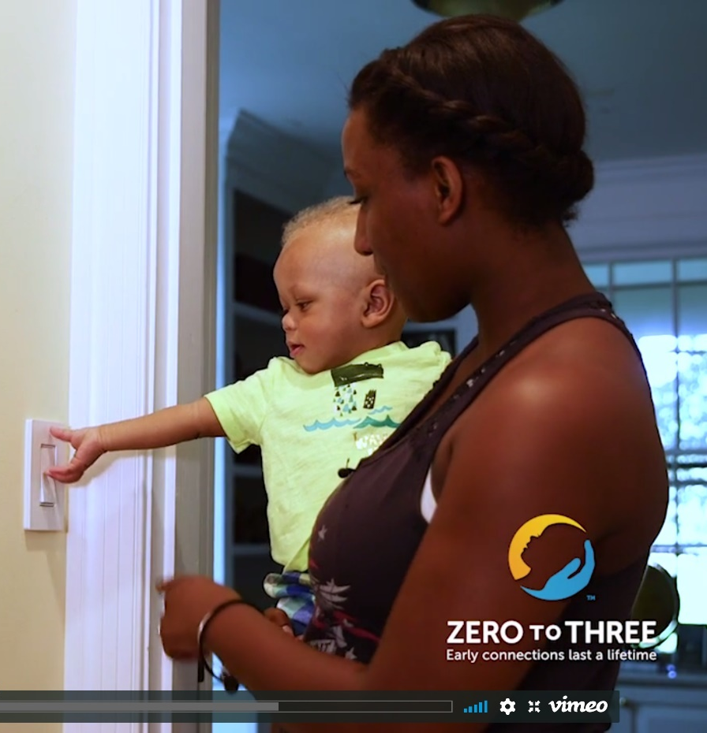
Excellence in Action: Engineering and Technology
Handouts, Page 3
In your handouts, respond to the following questions:
What connections can you make between what we just saw and the vision of math we’ve built thus far in our series?
How do you see the child engaging in
Problem-solving
Reflecting on their approach to problems
Productive struggle?
Extend your thinking: What connections do you see to the rubric?
Notes:
https://www.zerotothree.org/resources/1574-everyday-fun-with-technology-and-engineering-let-s-talk-about-stem-video
Watch and ask: What connections can you make between what we just saw and the vision of math we’ve built thus far in our series? (Will have them make explicit connections to the rubric.)
problem-solving
reflecting on their approach to problems
productive struggle
1 min: Set up video.
Now let’s watch a video to see engineering in action. As you observe, jot down notes in your handouts about the following questions.
3.5 min: Watch video
2 min. Partner discussion: What connections did you make? What stood out to you in this video?
3 min.: Whole group share out on partner discussion.
**note: for each video from zero to three, the website contains helpful guidance/a summary of what is covered:
Engineering and technology skill sets emerge as children explore:
Solving the problems they encounter in their world (and making their own problems to solve!);
Combining objects in new ways—stacking, lining up, nesting inside, and more;
Testing how things work, like pressing buttons on the television remote;
Changing part of a system, like the height of a ramp, and making predictions about what will happen; and
Using information about what works and doesn’t work to improve their creations.
Download a handout with activities designed to support young children’s growing pattern awareness from birth to 5.

Slide 9
Agenda
Opening
Why STEM?
Engineering and Technology
Science
Deep Dive: STEM in Action
Application: Plan and Practice
Closing

Slide 10
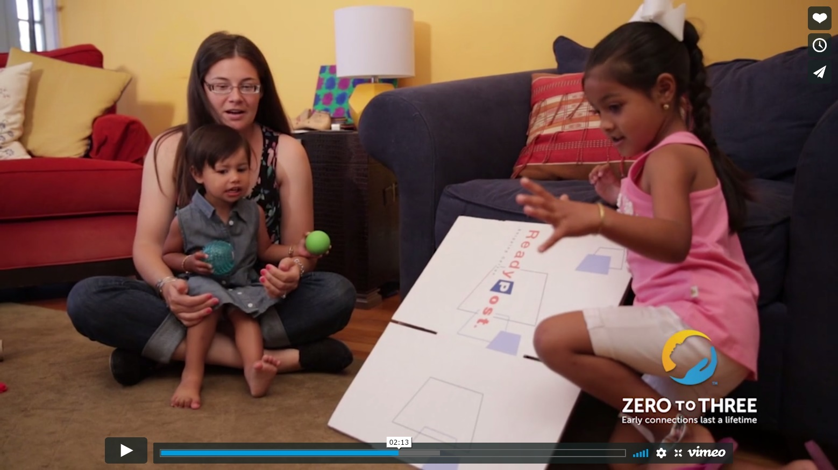
Excellence in Action: Science
Handouts, Page 4
In your handouts, consider:
What connections can you make between what you see in this video and the vision of math we’ve built thus far in our series?
Notes:
https://www.zerotothree.org/resources/1573-everyday-fun-with-science-let-s-talk-about-stem-video
1 min: Set up video.
Now let’s watch a video to see science in action. As you observe, jot down notes in your handouts about the question on the slide.
4 min: Watch video
2 min. Partner discussion: What connections did you make? What stood out to you in this video?
3 min.: Whole group share out on partner discussion.
What connections can you make between what you see in the video and the vision of math we’ve built thus far in our series? (Will have them make explicit connections to the rubric.)
similarities/differences
explaining their thinking
weight (we heard her mention it’s “heavy”)
problem-solving and reasoning
productive struggle
**note: for each video from zero to three, the website contains helpful guidance/a summary of what is covered:
An early understanding of science can be seen when children experiment with:
Making observations and noticing similarities and differences;
Asking questions;
Describing objects, animals, and plants, and natural processes like rainstorms;
Predicting what will happen next in a process;
Providing explanations for processes they observe—such as why there is thunder;
Using tools to further exploration, such as binoculars, a shovel, or a pulley.
Children also build science skills through an understanding of concepts and ideas that cut across many areas of learning—these include:
Patterns;
Cause and effect;
Scale, proportion, and quantity;
Energy and matter;
Structure and function; and
Stability and change.
Download a parent handout with activities designed to support young children’s growing science skills and knowledge from birth to 5.
Source: National Academies, Board on Science Education, 2011

Slide 11
Agenda
Opening
Why STEM?
Engineering and Technology
Science
Deep Dive: STEM in Action
Application: Plan and Practice
Closing

Slide 12
STEM in Action Deep Dive: How do we plan effectively for STEM opportunities?
Handouts, Page 5-6
Key Idea: Effective STEM opportunities are intentionally planned to align to math standards, build children’s problem solving skills, support them in productive struggle, and support them to explain their thinking.
What are key
components of planning
to keep in mind for
effective STEM
Integration?
1-Independently: Read through the NAEYC article for the static electricity task or the circuits task.
2-In pairs: Break down the static electricity task or the circuits task with a partner.
3-In groups of 4: Discuss what made these activities effective. What steps are needed in planning to ensure a STEM activity is fruitful?
Notes:
Facilitator prep needed: Make sure to have a way to assign groups for this.
1 min. Ask someone to read the key idea aloud. Introduce and set up the deep dive:
We will now look at 2 examples of STEM effectively planned, and then in our tables we’ll generate ideas of centers/stations/activities that already exist for us to build on in our planning. While one of these tasks will
You’ll read through the NAEYC article for your assigned task and work in pairs to discuss what made the activity effective—half of you will work on breaking down the static electricity task, half will focus on the circuits task. When you discuss, consider what you notice in the planning process here—what do you need to keep in mind/what have we learned about in previous sessions that you will apply here? Since we’ve just seen two examples of excellence, we now need to build our understanding of how to plan for this, not just why or what. There are some questions to guide you in your note-taker. After 4 min. you’ll come together to share out with one another about the other activity and what made it effective.
Finally, when we come back together, we’ll generate ideas of where there are opportunities to promote STEM intentionally already in your centers/classrooms. (When you do this, emphasize that we don’t want to have teachers feel like they need to create something new but rather that they should build on what they already have since they likely have spaces where they can be more intentional about how they use what already exists.)
4 min (parts 1 and 2): Independently read and then work in pairs to discuss/jot down notes.
6 min. Give participants time in groups of 4 to discuss what made these activities effective and share about the other activity. If time is available make sure to highlight that the key components of STEM activities are going to be very similar to what we’ve covered in our sessions before—like math talk, aligned to standards, problem-solving and reasoning opportunities, etc. None of this should sound BRAND new but rather it’s thinking about how to apply this in a new context and how to make STEM rigorous and intentional.
2.5 min. Have participants chart:
What centers/stations/activities in your rooms do you already have that support science exploration? How can you use those opportunities that already exist (like water tables, block tables, etc.) and plan more intentionally for them instead of feeling like you need to create something brand new?
1.5 min: Have group come back together to share out some of the activities/ideas they charted to set up planning/practice.

Slide 13
Agenda
Opening
Why STEM?
Engineering and Technology
Science
Deep Dive: STEM in Action
Application: Plan and Practice
Closing

Slide 14
Practice Part 1: PLAN
Handouts, Page 7-8
Based on our group brainstorming (what centers/stations/activities in your rooms do you already have that support STEM exploration?), pick one to focus on.
Use the guided process in your note-catcher to plan, keeping in mind the notes about effective STEM planning from our previous activity.
How can you use those opportunities that already exist (like water tables, block tables, etc.) and plan more intentionally for them instead of feeling like you need to create something brand new?
We’ll take photos of everyone’s plans and share with the group after feedback and revision!
Notes:
Leaders will identify one way they want to plan for STEM connections at their center--they’ll plan using the guided process in their note-catcher (which is very similar to what we used in the problem-solving session!). Encourage participants to choose something that already exists vs. creating something new.
Provide 6 minutes for participants to plan. In their handouts, there is a guided process to support their thinking.
After the practice, ASK: How did that practice feel? How do you see this being a valuable strategy when sharing this session to your staff?
Great guidance/resource we can share if needed: https://uca.edu/steminstitute/files/2011/07/Sand_and_WaterTCM2010-03-394a.pdf

Slide 15
Practice Part 2: Feedback and Revise
Handouts, Page 7-8
Revise
Swap back papers. Read through your partner’s feedback and revise your plan to make it stronger in line with our vision of excellence in STEM.
Feedback
Swap your paper with the person sitting next to you.
Read through the planned activity.
Note strengths as well as questions or areas of development.
Highlight the biggest glow and biggest grow.

Slide 16
Agenda
Opening
Why STEM?
Engineering and Technology
Science
Deep Dive: STEM in Action
Application: Plan and Practice
Closing

Slide 17
Exit Ticket
What are your next steps for ensuring that you are constantly and intentionally building supporting STEM with students?
When and where will you prioritize focusing on STEM? How will you hold yourself accountable for using these strategies?
What questions do you still have about what you learned today?
What feedback to you have about the session for the facilitator?
Next Steps for Teachers
Draft sentence starters that will help you remember to use STEM strategies daily. Post these prompts around your classroom strategically.
Have your prompts posted by PROVIDE DATE.
Notes:
Show this slide as just the sample for how to end the session with their staff
Direct participants to complete their Exit Ticket. Note that they should respond to the questions in their packet (will be the questions on the slide, but framed for leaders) and that this slide outlines what questions and expectations should be for their teachers.

